Slide 1
This is a template that has been designed for you to customize and use as your own when presenting a proposal to leadership re switching to peer learning. There is content in the notes section to guide the presenting radiologist. If you decide to share these slides you may want to delete that content. Depending on how much time you have to present, you can delete content as well. We have indicated in the notes which we think are required slides

Slide 2
Note, this slide deck does not include a detailed introduction into what peer learning is and how it works. You can prepare yourself for questions about this by watching the webinar available on the ACR Peer Learning Resources web page. In particular, we also recommend you watch the C-Suite webinar prior to your presentation, including the Q&A afterwards.

Slide 3
Modernizing Radiologist Performance Improvement
Transitioning from peer review to peer learning
Notes:
Insert your own logos here.

Slide 4
Transitioning to Peer Learning
Our call to action: Why Peer Learning is being adopted nationwide
How can we make this transition?
Our proposal for implementation and sustainability
Notes:
Introductory slide to explain plan presentation.
Our call to action: This is the “Why”
In this section you will discuss the history of the peer learning movement genesis
Explain why peer learning is important and how it will meet the facility’s strategies and mission statement
How?
Define how peer learning will meet regulatory requirements and how it will be separated from physician credentialling requirements
Explain how peer learning affects physician well-being
Prepare/Implement/Sustain
Discuss the C-Suite and radiology peer learning partnership in the creation of a peer learning policy and potential quality improvement initiatives
Discuss key roles and required resources
Discuss workflows
Discuss sustainability

Slide 5
What is Peer Learning?
Group activity where expert professionals share learning opportunities and actively discuss errors, good catches and near misses in a constructive manner to teach and learn from one another with the goal of improving physician performance
Shared goal of improvement of services by relying on the establishment of trust and free exchange of feedback in a constructive and professional manner
Designed to result in systems improvement projects

Slide 6
WHY PEER LEARNING?
Our call to action

Slide 7

Institute of Medicine 1999: To Err is Human: Building a Safer Health System
~44,000-98,000 deaths/year due to medical error
Medical error: failure of a planned action to be completed as intended or the use of a wrong plan to achieve an aim
Costs
Majority of errors caused by faulty systems, processes, & conditions
Blaming an individual does little to make the system safer & prevent someone else from committing the same error
Financial: $17-29 billion/year
Patients: Loss of trust
Health Professionals: Loss of morale
Notes:
Required slide. Focus on last two points: We need to fix systems. Blaming individuals does not fix systems.

Slide 8
Score-based Peer Review-RADPEER (2002)
Program
National, uniform in structure & function, accurate, facile, nonpunitive, integrated into facilities QA program
When a new imaging study interpreted with an older study for comparison → assess accuracy of interpretation of the older study
Tabulate data to yield imaging modality, location, and radiologist specific error rates
JACR 2004; 1:59-65
Notes:
Required slide. Organized radiology responded to the Err is Human report by establishing a scored-based peer review system to try to see where errors where occurring.

Slide 9
Score-Based Peer Review Limitations
Lack of agreement in meaning of “peer review”
Tension, distrust, bias
Underreporting of errors
Not easily actionable
No meaningful effect on organizational performance or practice improvement
Focus on scoring peers as opposed to improving patient care
Notes:
Required slide. Although well-intended, it has been shown over the years that this scored peer review system is deeply flawed, and can actually be harmful in that it can break down trust. Nevertheless, many people have been using it for lack of a better system.

Slide 10

Institute of Medicine 2015: Improving Diagnosis in Health Care
Diagnostic error (persistent substantial problem)
1 in 20 U.S. adults who seek outpatient care each year will experience a diagnostic error
Diagnostic errors contribute to approximately 10% patient deaths (postmortem research)
failure to establish an accurate & timely explanation of the patient's health problem(s)
failure to communicate that explanation to the patient
Notes:
Required slide. In 2015, the IOM focused on the role diagnostic error plays in patient harm, reinvigorating the thought process around this issue.

Slide 11
Institute of Medicine 2015 Improving Diagnosis in Health Care: Goals to Reduce Diagnostic Error & Improve Diagnosis
Facilitate more effective teamwork in the diagnostic process among health care professionals, patients and their families.
Enhance health care professional education and training in the diagnostic process.
Ensure that health information technologies (IT) support patients and health care professionals in the diagnostic process.
Develop & deploy approaches to identify, learn from, and reduce diagnostic errors and near misses in clinical practice.
Establish a work system and culture that supports the diagnostic process and improvements in diagnostic performance.
Develop a reporting environment and medical liability system that facilitates improved diagnosis through learning from diagnostic errors and near misses.
Design a payment and care delivery environment that supports the diagnostic process.
Provide dedicated funding for research on the diagnostic process and diagnostic errors.
Notes:
Do not need to read all these, but can refer to the most important ones (1,2, 4, 5)

Slide 12
Agency for Healthcare Quality and Research (AHRQ): Culture of Safety
Errors identified and mitigated before harm occurs
Systems are in place to enable staff to learn from errors and near-misses and prevent recurrence
Healthcare professionals are held accountable for unprofessional conduct, yet not punished for human mistakes
AHRQ PSNet Safety Culture 2014
Notes:
The AHQR also highlighted the importance of establishing a culture of safety with these features.

Slide 13
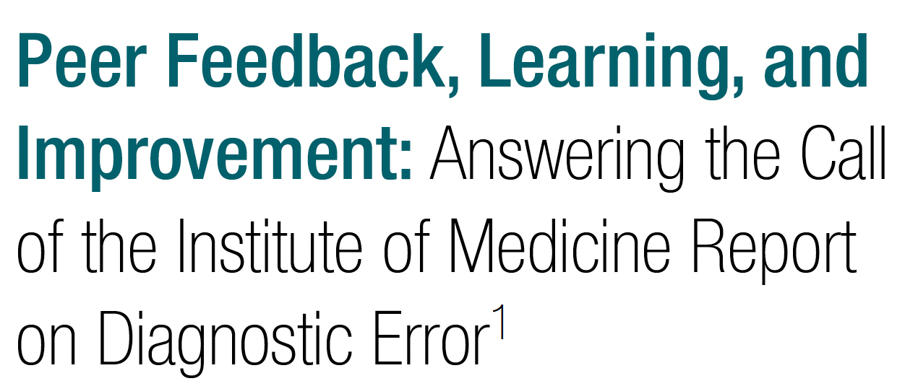
Adapting the 2015 IOM Goals to the Radiology Specialty: Peer Learning
Radiology 2017; 283:231-241
Notes:
Required slide. In 2017, in response to the IOM report, several radiology thought leaders proposed a different system, where learning opportunities could be shared without judgment for the purposes of learning among staff, and leveraged to create sustained improvement.

Slide 14
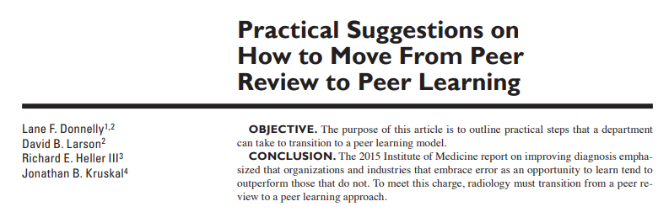
Radiology Literature and Thought Leaders Endorse Transitioning from Peer Review to Peer Learning
CONCLUSION: The 2015 Institute of Medicine report on improving diagnosis emphasized that organizations and industries that embrace error as an opportunity to learn tend to outperform those that do not. To meet this charge, radiology must transition from a peer review to a peer learning approach.
AJR 2018; 210:578-582
Notes:
Required slide.

Slide 15
Peer Learning and Mission Statement
< Insert facility mission statement>
Peer learning meets our facility’s mission statement by offering the following:
<Insert first statement>
<insert 2nd statement>
Etc.
Notes:
Required slide. You should insert your client organizations mission statement here and connect that mission statement to what peer learning can achieve. If there are any other client initiatives that are similar or benefit peer learning they also can be highlighted here.

Slide 16
HOW CAN WE MAKE THIS TRANSITION?

Slide 17
Peer Review to Peer Learning Transition
Peer Review
Score 1 (Concur with Interpretation)
Score 2 (Discrepancy in interpretation/not ordinarily expected to be made; understandable miss)
a. Unlikely to be clinically significant
b. Likely to be clinically significant
Score 3 (Discrepancy in interpretation/should be made most of the time)
a. Unlikely to be clinically significant
b. likely to be clinically significant
Peer Learning
Agree
Great Call
Learning Opportunity
Perception
Cognition
Technical/Protocol
Reporting
Communication
Radiologist recommendations
Other process related opportunity
Notes:
Required slide. The transition is not difficult in day to day operations. Rather than scoring we focus on education.

Slide 18
Peer Learning and Major National Organizations
No Regulatory Requirement Prohibiting Transitioning from Peer Review to Peer Learning
The Joint Commission | Ongoing Professional Practice Evaluation (OPPE) is required Peer Review is not REQUIRED but can be used for OPPE Nothing that would prohibit utilization of Peer Learning (can be used to satisfy OPPE)
CMS | No mention of Peer Review
American Board of Radiology | No requirements of Peer Review Participation in a Peer Learning program would meet Part IV Maintenance of Certification (MOC) requirements
American College of Radiology | Accreditation* Program requirements can be satisfied with Peer Learning
American College of Surgeons | Score-Based peer review not required for trauma accreditation
*Accreditations are important to not-for-profit hospitals regarding their bond ratings.
Notes:
Required slide. There are no barriers to adoption by national accreditation organizations. ACR and ABR have moved to support adoption of peer learning.

Slide 19
Distinction between peer learning and physician credentialling
Peer learning and performance evaluation are separate concepts and should remain distinct.
OPPE (Online Professional Practice Evaluation) requirements for credentialling will need to be separate and not involve or include score-based peer review
Collaboration with credentialling leadership to ensure that all regulatory requirements for OPPE can be met performed in an efficient manner
Notes:
Required slide. (You should arrive with a proposal of how OPPE will be performed, ideally already vetted with credentialing leadership, so you can answer any questions to this end)

Slide 20
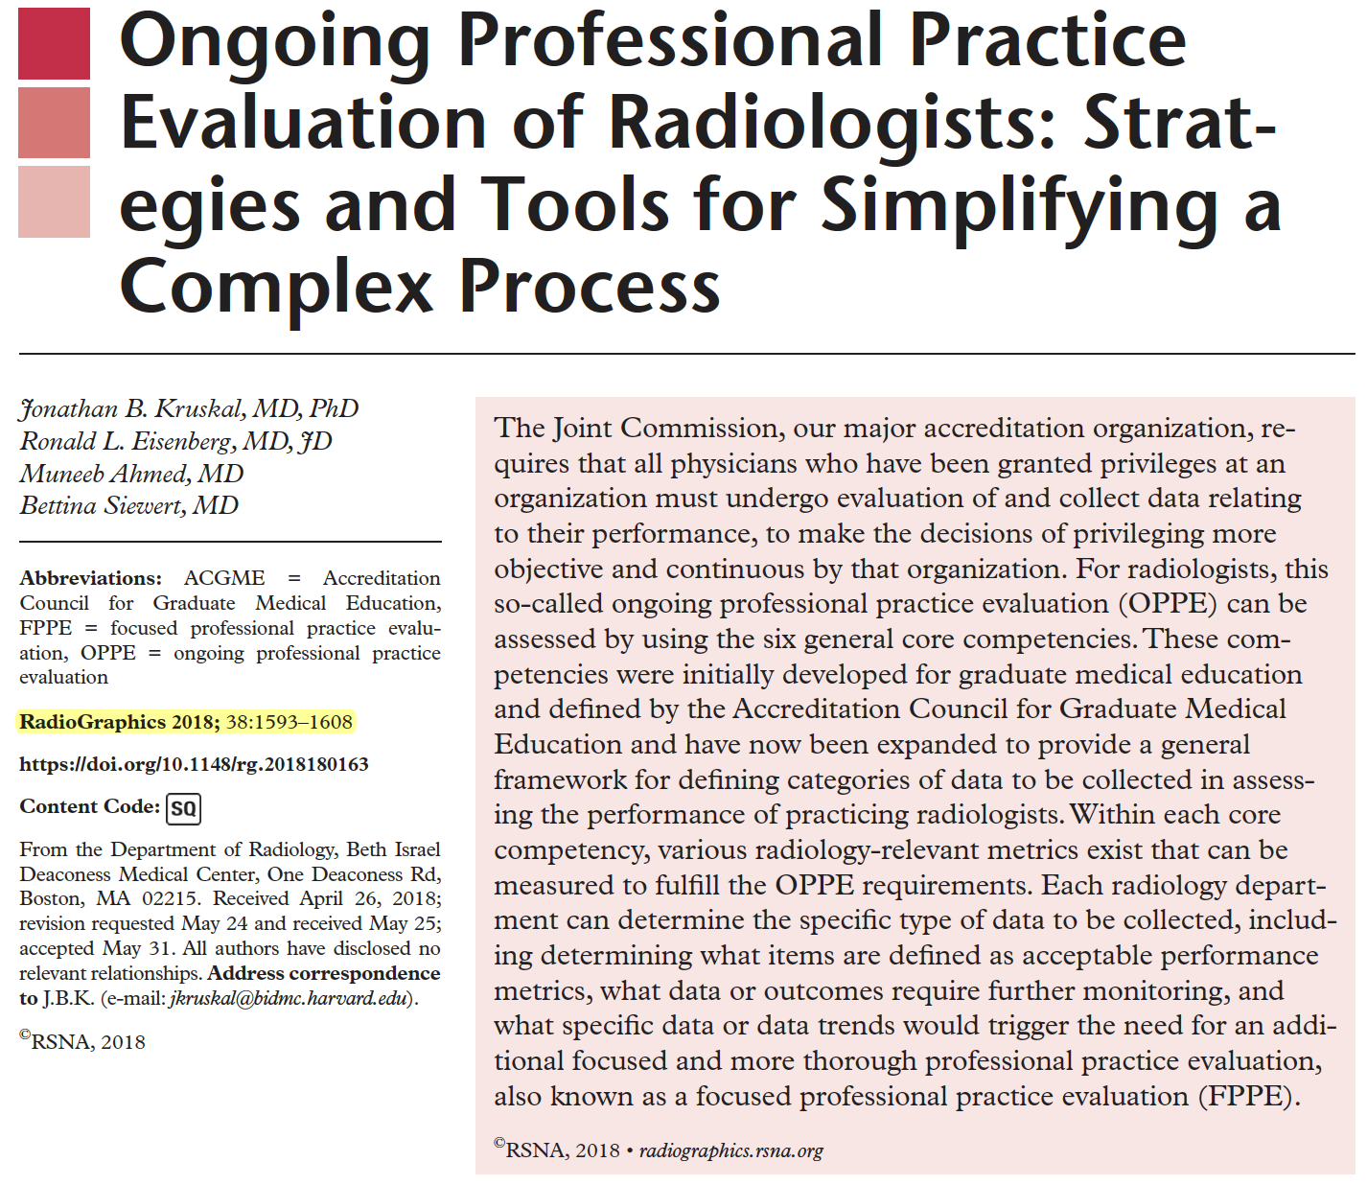
Separate from Performance Evaluation
ACGME Core Competency | Examples of Radiology Performance Metrics
Patient care & procedural skills | Report edits, addenda or errors
 | Compliance with policies
 | Procedure outcomes (IR)
 | Incident reports a/o events
Medical knowledge | CME
 | Multisource feedback from colleagues
Practice-based learning & improvement | Participation in practice/dept/system quality improvement projects
 | Teaching profile
 | Trainee feedback
 | Educational media
Interpersonal & communication skills | Multisource feedback from colleagues
 | Relationships with medical and hospital staff
 | Compliments/complaints
 | Reports complete and within standards
Professionalism | Multisource feedback from colleagues
 | Punctuality
 | Accountable for personal behavior
 | Timely response to concerns, admin requests
 | Meeting attendance and participation
Systems-base practice | Peer learning submissions
 | Participation in multidisciplinary conferences
 | Feedback from peers, staff
Performance evaluation without scored peer review.
Notes:
Required slide. (You should arrive with a proposal of how evaluation will be performed.)

Slide 21
Bonus: Supports Physician Well-being
Aligns with efforts to support physician well-being
Fosters a comfortable and supportive work environment
Reduce the fear and shame of disclosure of error
Culture of learning and improvement, minimizing blame
Acknowledgment and amplification of ”great calls”
Notes:
Required slide.

Slide 22
PREPARE/IMPLEMENT and SUSTAIN
Notes:
Required slide.

Slide 23
Peer Learning Policy
Plan for joint effort to develop policy in partnership with executive leadership
Examples of peer learning opportunities at our facility may be defined as
Actual or potential performance issues
Discrepancies
Great calls
Near misses
<Insert other opportunities related to your practice>
Peer learning opportunities may be identified during:
Routine course work
Case conferences
<Insert other opportunities related to your practice>
Notes:
Required. If you have already drafted a policy, you can insert a screen capture. Can mention, if it will help, that it includes components meeting ACR accreditation requirements and is based on samples provided by ACR.

Slide 24
Key Roles and Resources
Peer Learning Leader- <Insert name of the peer learning leader at your facility>
C-Suite liaison- <insert name of the C-Suite liaison at your facility>
Administrative support- <insert name of the administrative support that will assist in peer learning coordination>
Additional personnel resources needed include: <If applicable: Insert additional resources required for your facility>
The amount of time or percentage of full-time equivalent (FTE) hours to be dedicated to managing the peer learning facility is expected to be < Insert here>.
Notes:
Required.

Slide 25
Accountability
The Peer Learning leader will be accountable for the following:
Promote the peer learning program to all radiologists
Develop and maintain peer learning workflows
Receive and review peer learning opportunity submissions
<insert other responsibilities for your peer learning leader>
The C-suite will be accountable for:
Working with the peer learning leader to translate findings from peer learning activities into dedicated quality improvement efforts
Provide the additional resources needed to support the radiology peer learning program
<insert other responsibilities for your C-Suite>
Notes:
Optional. Only if applies.

Slide 26
Workflows
Submission of learning opportunities
<insert method your facility will utilize for the submission of learning opportunities>
Review of submissions by peer learning program leaders
<insert process of review of submissions by PL leader>
Content organization and archiving
<insert process for content organization>
Presentation of peer learning opportunities
<insert process of learning opportunities presentation>
Quality Improvement efforts
<insert process of tracking quality improvement efforts>
Notes:
Optional. They may not be interested in or have time for the the exact details of how your program is going to run.

Slide 27
Targets
Minimum participation by the radiologists in peer learning submissions is <insert example targeted submission number>
Minimum participation by the radiologists in peer learning activity participation is <insert example targeted participation number>
Minimum standards for peer learning program activities includes <insert example minimum standards>
Notes:
Optional. They may not be interested in or have time for the the exact details of how your program is going to run.

Slide 28
Sample Peer Learning Metrics
Peer learning opportunities submitted in total and by each radiologist
Peer learning opportunities reviewed by each radiologist
Improvement activities resulting from peer learning opportunities
Peer learning conferences held
Peer learning conferences attended by each radiologist
Notes:
Optional. They may not be interested in or have time for the the exact details of how your program is going to run.

Slide 29
Sample Metrics (Quarterly)
# of peer learning opportunities submitted in total and by each radiologist
# of peer learning opportunities reviewed by each radiologist
# of improvement activities resulting from peer learning opportunities
# peer learning conferences held
# of peer learning conferences attended by each radiologist
Notes:
Optional. They may not be interested in or have time for the the exact details of how your program is going to run.

Slide 30
Advancing Movement- Radiology Peer Learning Publications (Pubmed)
Notes:
Required.

Slide 31
Advancing Movement- Peer Learning Publications (Pubmed)
Notes:
Required.

Slide 32
Conclusion
Peer learning is a physician quality improvement process that
focuses on individual and group learning & systems improvement
allows for opportunities of feedback without judgement
helps build community and improved teamwork between practice members
We are prepared to deploy this program and reap the benefits for our patients, our clinicians, and the institution.
Notes:
Required.

