Slide 1
Radiology Skills Workshop for Medical Students
American College of Radiology’s
Medical Education & Student Outreach (MESO) Team

Slide 2
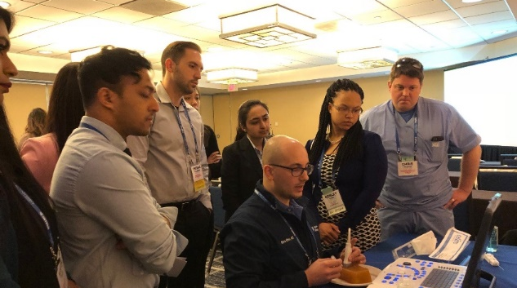

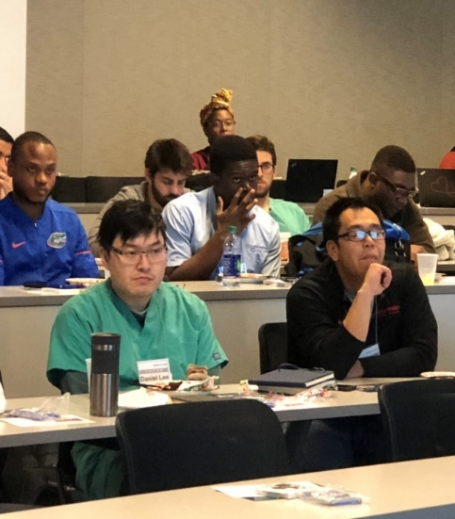
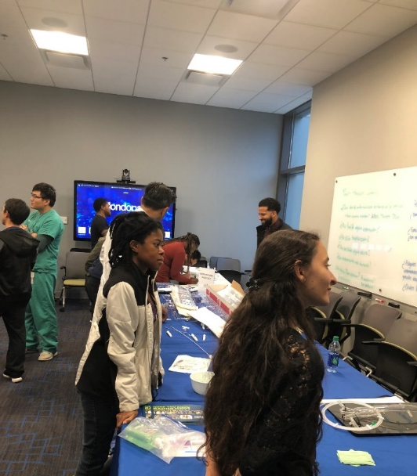
Timeframe: 1½ - 2hrs
Space Requirements: 2 rooms
Classroom for Food & Beverages, Presentations and a large open space for 3-6 Stations.

Slide 3
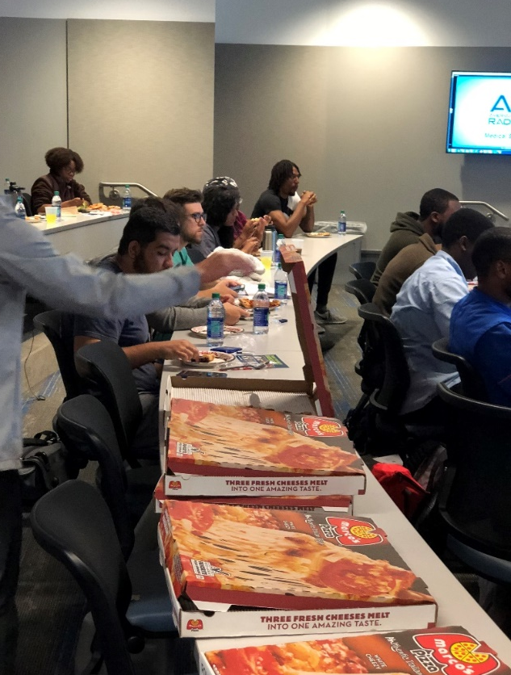
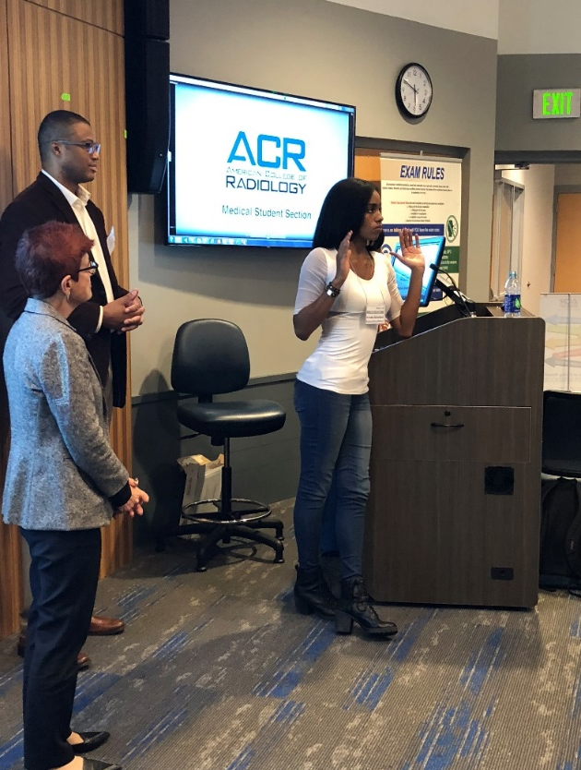
First 30-45 minutes:
Provide refreshments
Show short video about Radiology
Volunteer Physician Leaders speak and answer questions
If available, allow former PIER* Interns to speak about their experience.
* Pipeline Initiative for the Enrichment of Radiology

Slide 4
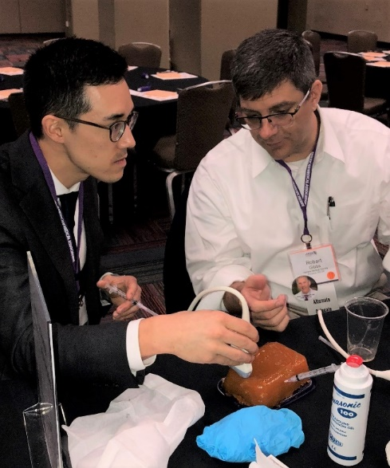
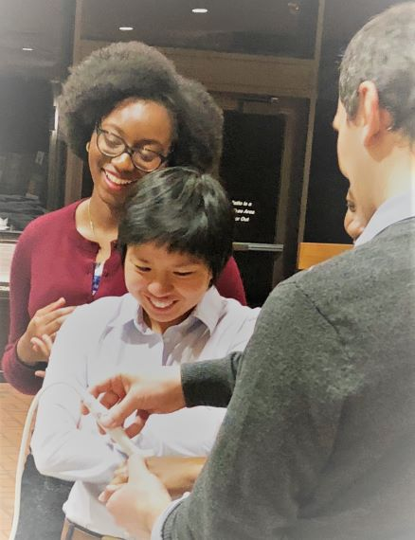
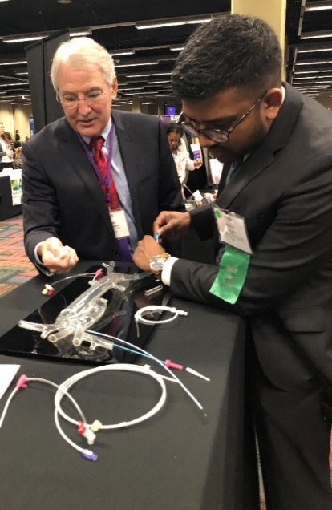
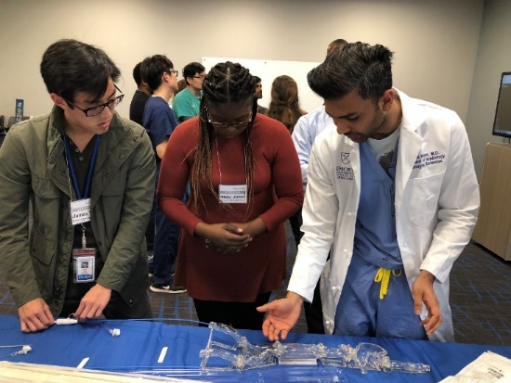
1-1½ Hours: Hands-on Demonstrations
Medical students rotate in groups among stations
ULTRASOUND-GUIDED PROCEDURES:
Biopsies & Aspirations using homemade phantoms
Other Options: Body Scanning; Doppler Flow Studies
INTERVENTIONAL PROCEDURES:
“Angio Sam”: Catheterization
“Filtering Fran”: IVC Filter Placement/Retrieval

Slide 5
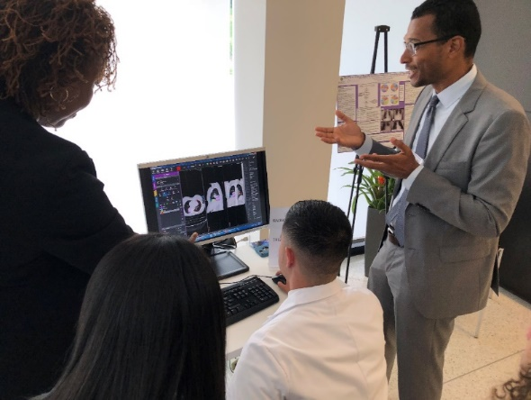
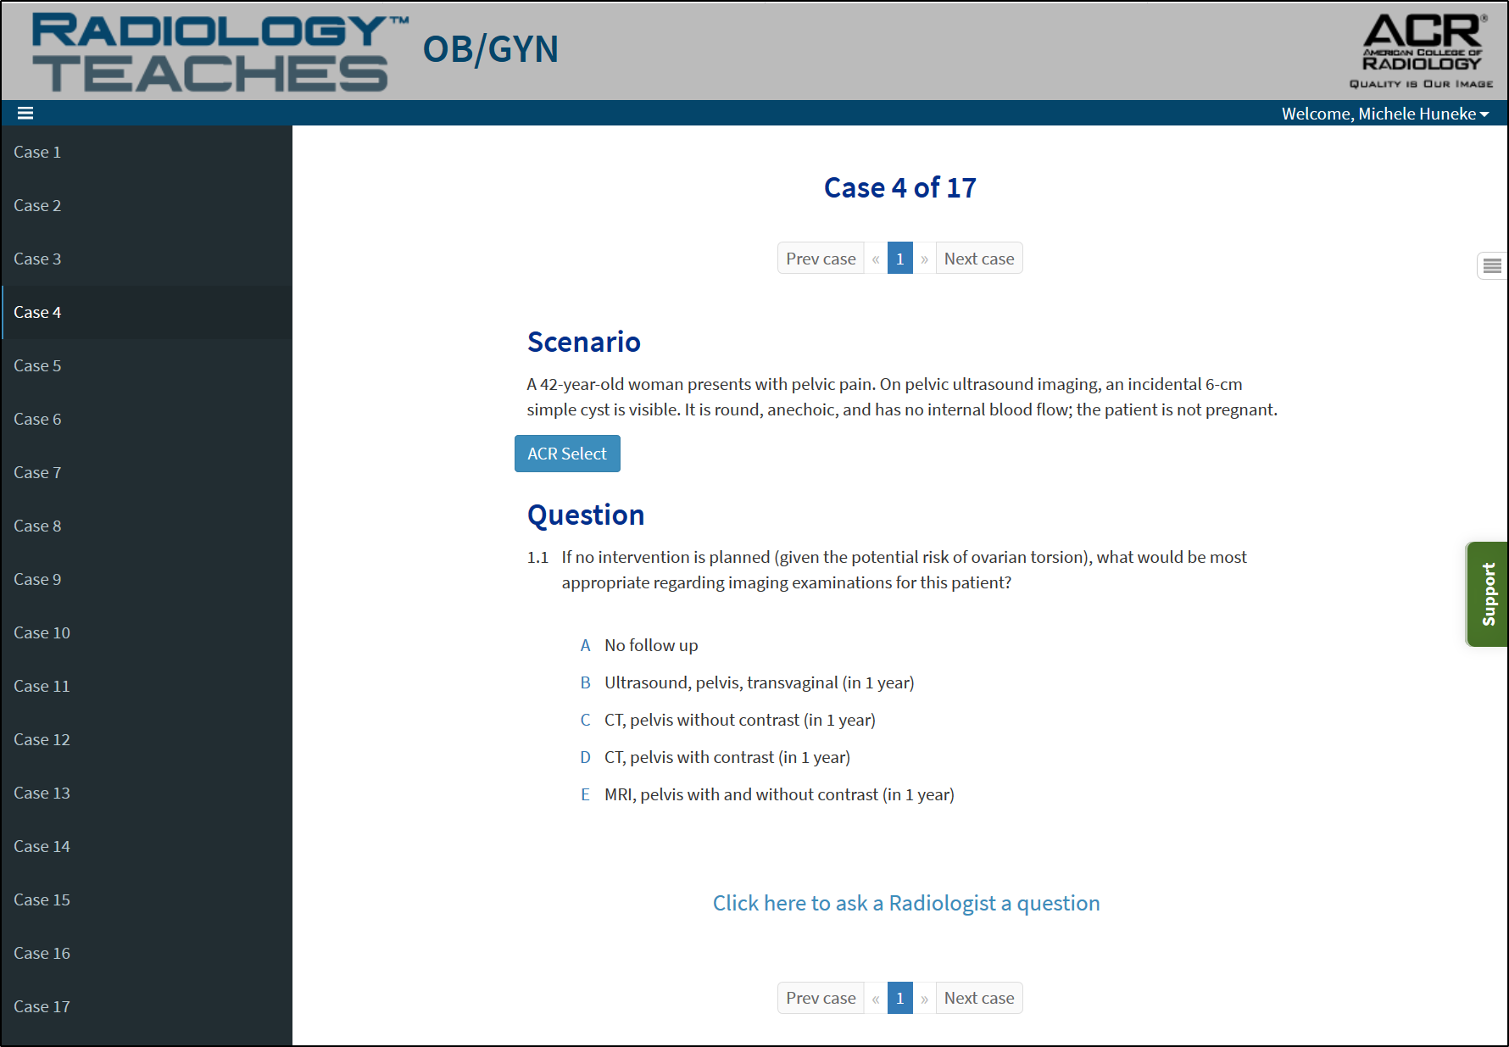
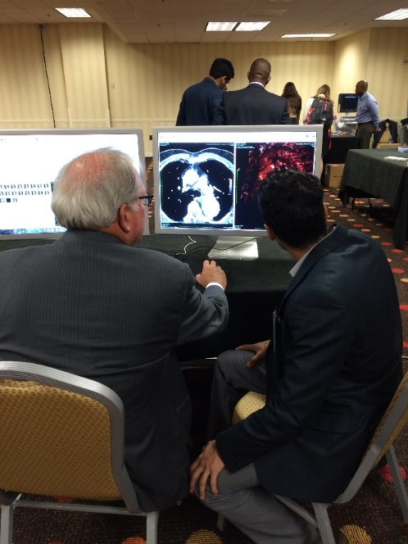
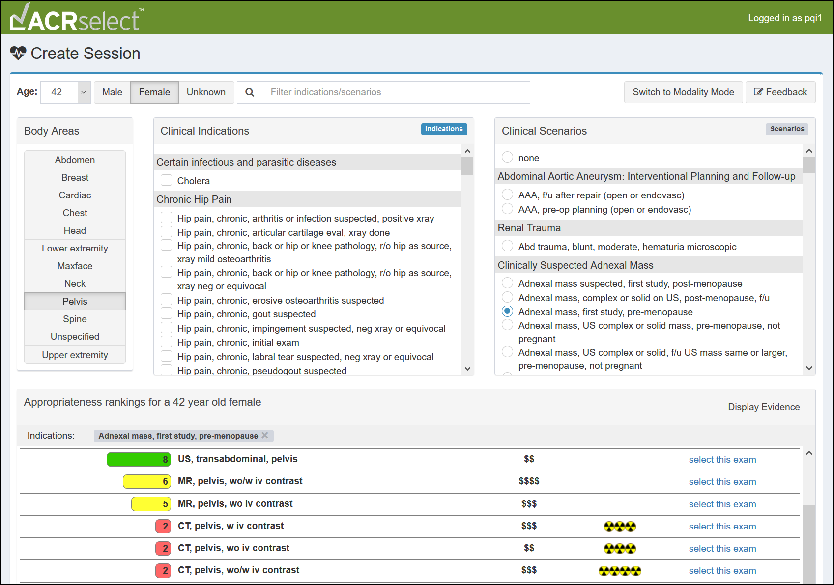
Additional Stations
RADIATION ONCOLOGY
MIM Software: Radiation Treatment Planning
Radiology-TEACHES:
Education on Appropriate Imaging using ACR Select Clinical Decision Support
PACS STATION:
Display images in various modalities

Slide 6
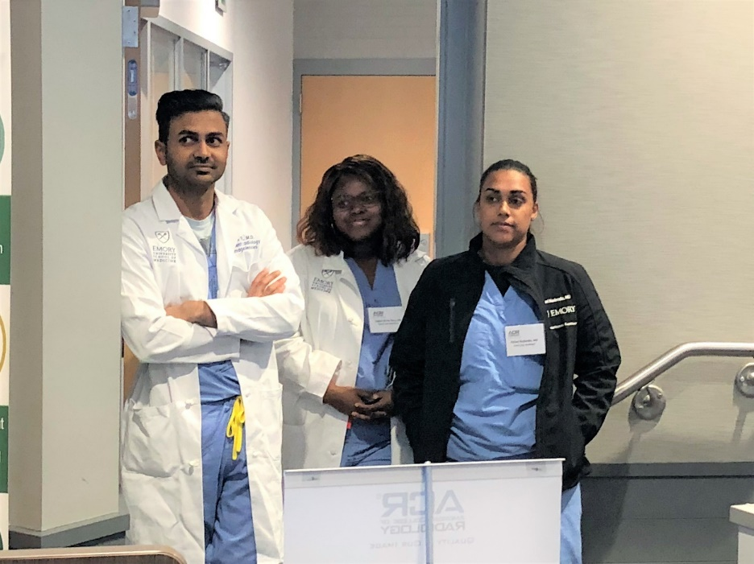
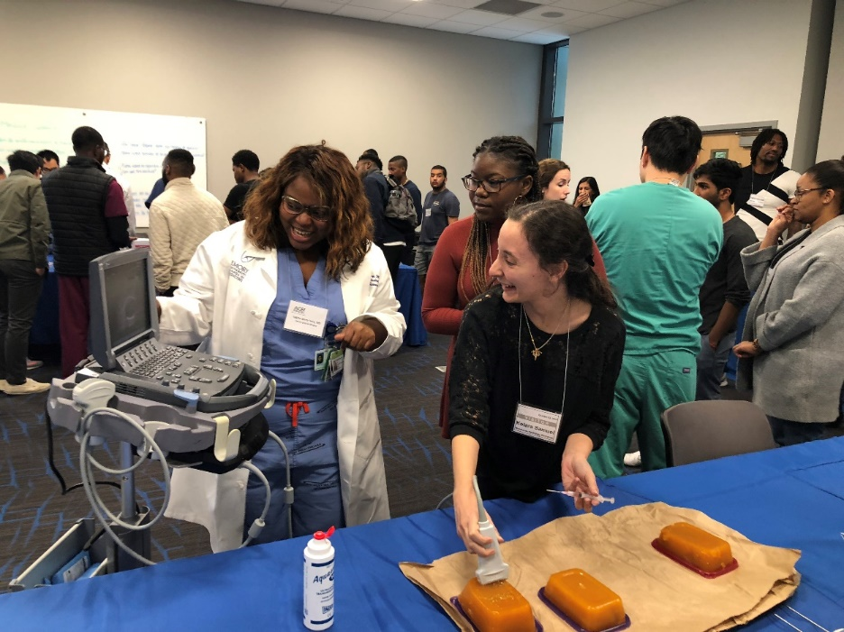
Recruit Radiology/Radiation Oncology Volunteers One for each station

Slide 7
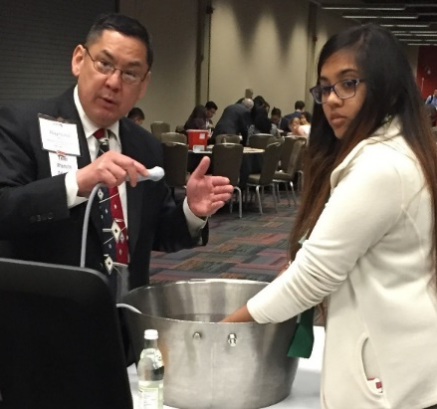
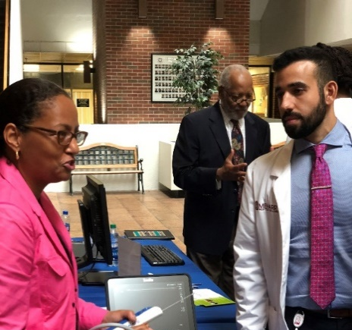
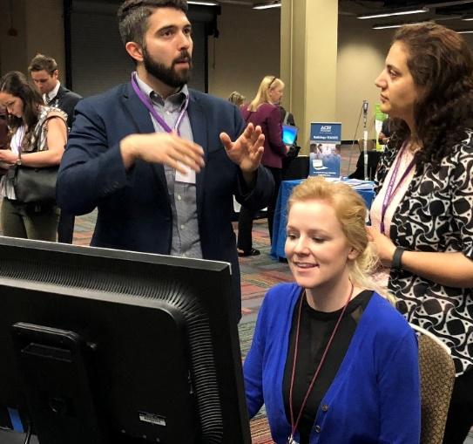
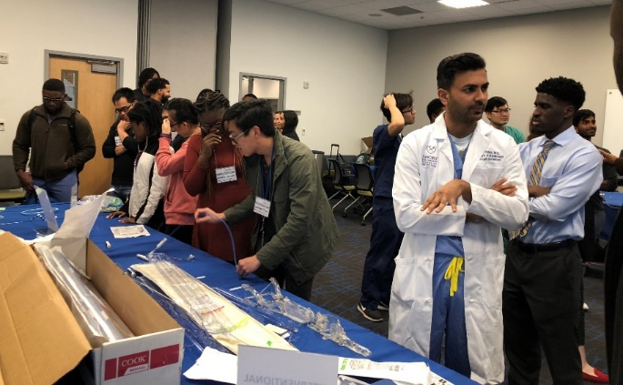
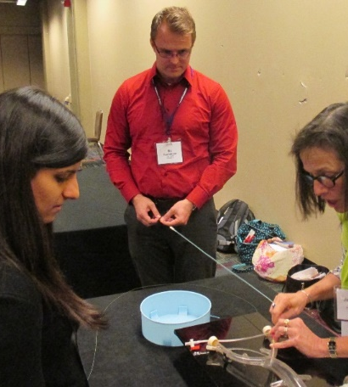
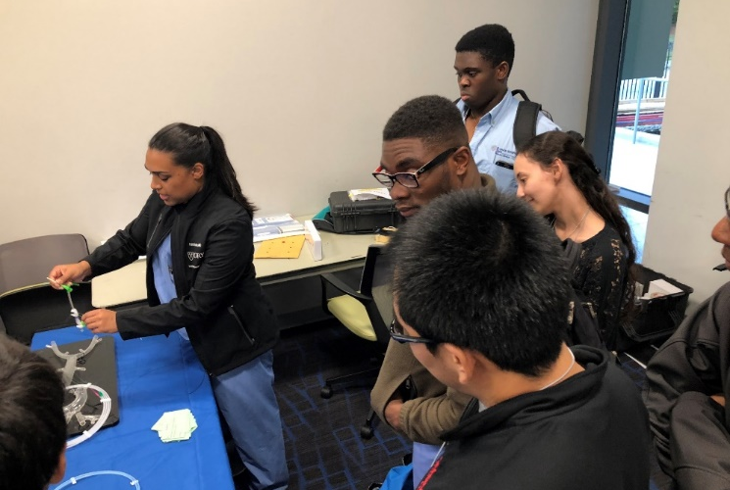
Photos of Hands-on Demonstrations
Medical students rotate in groups among stations

Slide 8
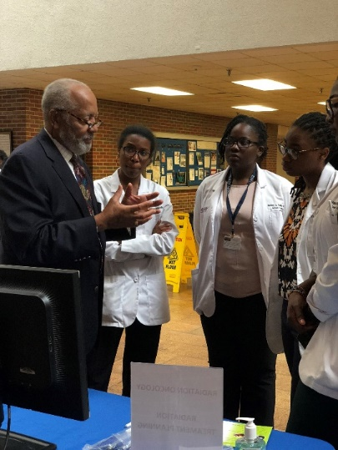
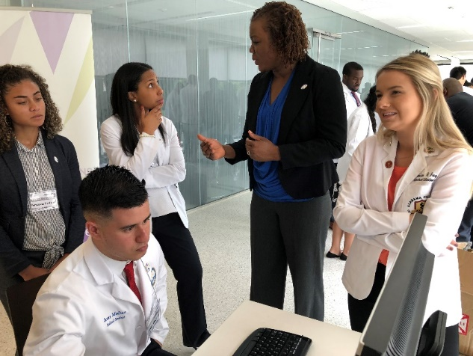
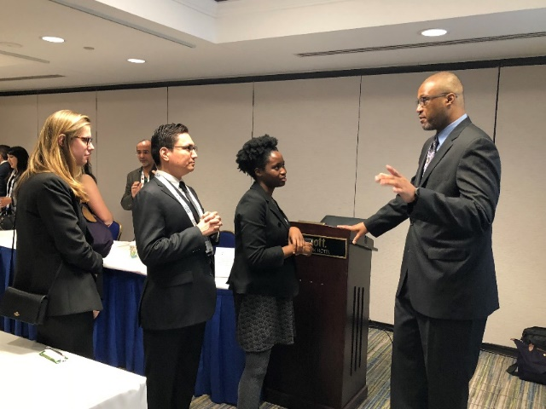
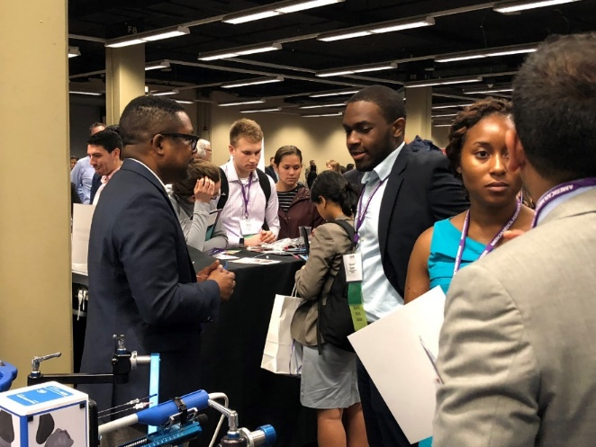
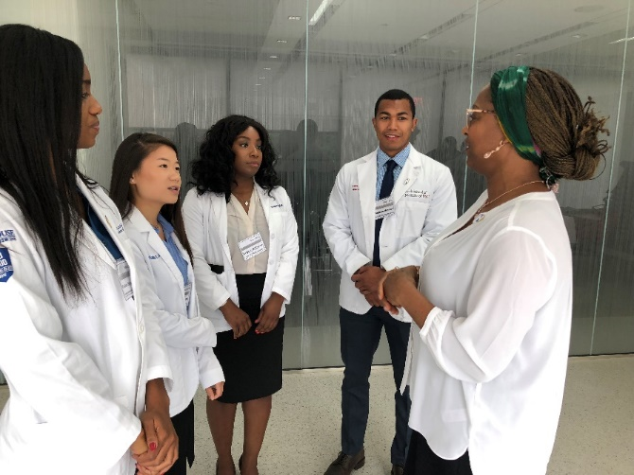
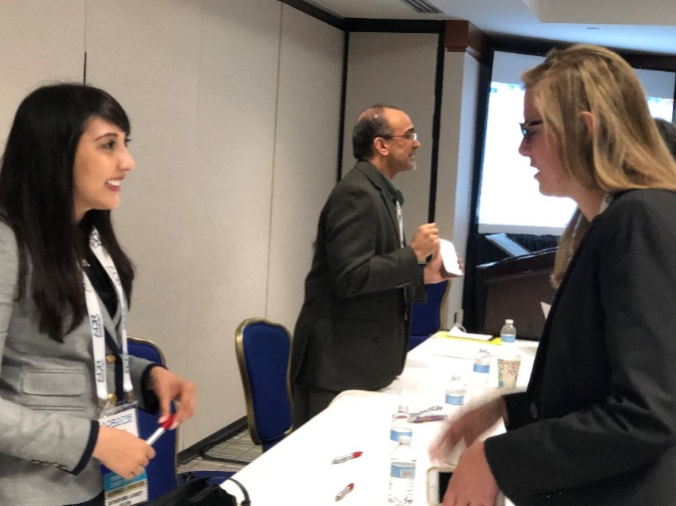
Allow time for questions.

Slide 9
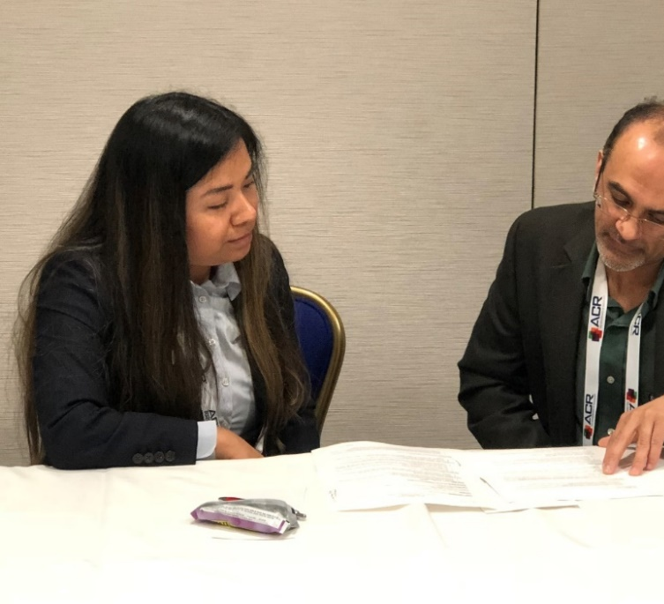
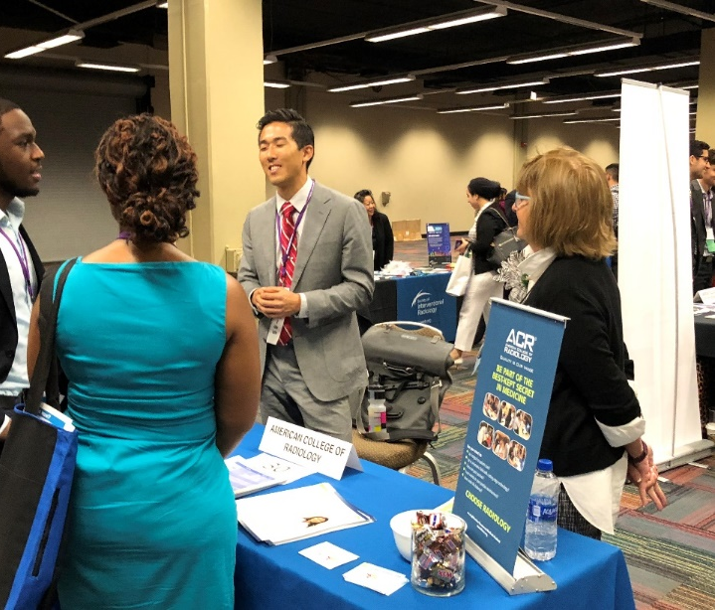
Collect Contact Information and Follow Up with Attendees Become a Mentor Encourage radiology-minded students to join the ACR. It’s FREE. https://www.acr.org/Member-Resources/Medical-Student/Medical-Student-Hub/Member-Benefits

Slide 10
Questions? Contact ACR Staff
Medical Education and Student Outreach (MESO)
Joan Lynch jlynch@acr.org
Angelica Vergel de Dios avergeldedios@acr.org
ACR PIER Internship
Carla Brathwaite cbrathwaite@acr.org
Angelica Vergel de Dios avergeldedios@acr.org
Radiology-TEACHES
Michele Huneke mhuneke@acr.org

