Slide 1
ACR Economics Update: Radiology Payment and Reimbursement
Speaker Name
Title
Notes:
We are here today to talk about a topic of critical importance to the radiology community – payment and reimbursement.
As part of our discussion about today’s challenges and future opportunities for radiology, we will cover:
What’s Happening in Reimbursement?
The ACR Coding and Nomenclature Committee
The ACR Relative Value Update Committee (RUC)
Tools for Radiologists

Slide 2
What’s Happening in Reimbursement?
Optional: Embed video clip of Dr. Geraldine McGinty here
Notes:
Before we get started, I’d like to play a short video about payment and reimbursement by the ACR’s Chair of the Economics Commission, Dr. Geraldine McGinty.

Slide 3
What’s Happening in Reimbursement?
The CMS and HHS agenda:
Drive reimbursement to primary care
Reduce unit reimbursement for imaging to manage utilization
Reduce overall spending
Respond to “outside” pressure (e.g., MedPAC)
Notes:
Today, cost of health care is a primary concern of policy makers, particularly the Centers for Medicare & Medicaid Services and the Health and Human Services agency. They are looking at payment models, population health, accountable care organizations, and numerous other options to save money.
Until there are alternate payment systems in place, fee-for-service models will be the focus of cuts to reimbursement and utilization management in order to reduce overall spending.
In the face of these challenges, the ACR is working with CMS to ensure proper payment and reimbursement for radiology services.
Here are some updates from the two ACR committees who are at the forefront of that initiative: the ACR Coding & Nomenclature Committee and the ACR Relative Value Update Committee (RUC).

Slide 4
ACR Coding and Nomenclature Committee
Works with CPT Editorial Panel to optimize payment and reimbursement for radiologists under Fee-for-Service.
The CPT Editorial Panel operates under the auspices of the AMA.
11 physician representatives
One representative from various industry groups
Radiology is NOT guaranteed a seat at the table.
Notes:
The ACR continues to be busy at the CPT Editorial Panel through the Coding & Nomenclature Committee.
On the CPT Editorial Panel, there are 11 physician representatives, who are appointed by the AMA Board of Trustees.
The panel also includes one representative each from leading industry groups, including:
-The Blue Cross & Blue Shield Association
-The American Hospital Association
-The American’s Health Insurance Plans
-The Centers for Medicare and Medicaid Services
-The Health Care Professionals Advisory Committee (HCPAC)
It is important to note that radiology is NOT guaranteed a seat! But we have been represented over the past few years by a number of excellent radiologists.

Slide 5
CPT Editorial Panel
2014 cycle (completed in February 2013)
New Cat I codes – 27
Deleted codes – 23
Revised codes – 2
New Cat III codes – 4
Cat III code extensions – 1
26 new codes resulted from the mandate to bundle.
Notes:
The ACR continues to be busy at the CPT Editorial Panel.
There are many changes coming as a result of the 2014 cycle. In January, new codes, deleted codes, revised codes, and more changes go into effect.
Most of these new codes were due to the mandate to bundle.
Some of new bundled codes in effect as of January 2014 include breast biopsy, needle localization and clip placement; embolization; abscess drainage; and vascular stent placement.
There is more bundling coming our way in the future, including DXA with vertebral fracture assessment; myelography; vertebroplasty/kyphoplasty; biliary and GU interventions; and hip and pelvis plain film.

Slide 6
Unrelenting Pressure to Bundle
The vast majority of our committee work is due to the mandate to bundle component codes.
The ACR has fought long and hard against these bundling mandates. But bundling is today’s reality.
We must stay engaged to protect the best interests of the radiology community.
Notes:
The vast majority of the ACR Coding & Nomenclature Committee’s work is due to the mandate to bundle component codes, which means combining existing CPT codes into new standalone CPT codes.
All medical specialties are impacted by the mandate to bundle codes, but radiology is particularly hard hit due to the basic structure of our codes. Component coding is widely used in radiology. Many people think about it as being mostly used by interventional radiology coding, but it is actually much of what we do – CT/MR/US/Nuc Med, even the plain film area uses component coding. Unfortunately the CPT and RUC are hostile to component coding and have implemented mandates for bundling services that are frequently performed together.
To protect the radiology community’s interests, we have fought long and hard against bundling mandates. But eventually the pressures at CPT and RUC became too great. Today, there is general agreement that component coding is no longer a viable model; no new component codes are making it through CPT.
Simply put, bundling is today’s reality, and I don’t need to tell you that it continues to have a significant impact on reimbursement.
It is critically important that ACR stays engaged in this painful process to look out for the best interests of the radiology community. At the same time we need to explore other models for getting paid for what we do.

Slide 7
Relative Value Update Committee
CMS is focused on identifying “potentially mis-valued” services.
Numerous radiology codes have been targeted for bundling.
Result = sharp reductions in payments.
Notes:
CMS has been quite focused recently on identifying "potentially mis-valued" service, which has led to a large number of radiology codes being identified.
As we’ve just discussed, the result has been bundling and revaluation, often with sharp reductions in payment.

Slide 8
R
B
R
V
S
Resource
Based
Relative
Value
Scale
American Medical Association
Specialty Society
R
U
C
Relative Value Scale
Update
Committee
Notes:
When we talk about payment for physician services within the Medicare Physician Scale, the current, most commonly used model is the RBRVS (or Resource Based Relative Value Scale). It is a scale of value. In a radiology service, the value is determined based on its relativity compared to other existing services across all specialties.
Payment within the Medicare system is based on the RBRVS -- in which Relative Value Units (RVUs) are assigned for professional and technical component services. Your position on this relative value scale is based on the resources required for a physician to provide that service.
Now let’s talk a little bit about relative value and how it is determined.

Slide 9
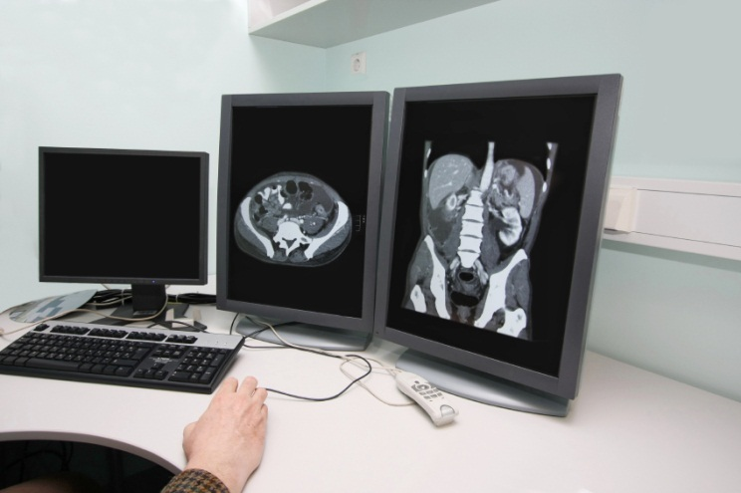
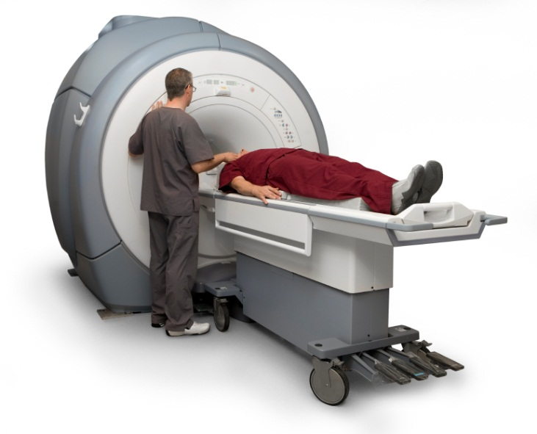
Total RVU
+
Work RVU
(PC)
Practice Expense RVU (TC)
Notes:
First let’s look at what’s called Total RVUs (Relative Value Units), which is the currency we use within the RBRVS.
There are a couple of components to that:
The Work RVU is the work you perform as a physician interpreting an examination.
Then there is the Practice Expense RVU, which is cost a physician incurs in providing a service (for example, staff, equipment, supplies, etc.)

Slide 10
ACR
RUC
CMS
Refine-ment Panel
CMS
FINAL
Notes:
The task of maintaining the RBRVS falls upon the Relative Value Scale Update Committee (or RUC). Radiology is very fortunate in that we have a permanent seat on the RUC. That role is to serve as an independent individual evaluating the RBRVS – one who cannot advocate for radiology. However, the ACR also has an Advisory Committee charged with presenting recommendations and codes to the RUC. That committee is a strong advocate for radiology.
Making recommendations to the RUC happens in a sequence:
The ACR makes recommendations to the RUC.
The RUC considers our recommendations and determines what to take forward to CMS.
They may or may not require refinement.
It goes back to CMS.
Then the final decision is made.

Slide 11
Making RUC Recommendations
ACR works with specialty societies to prepare and submit work and PE recommendations.
Values approved at the RUC are not final.
CMS reviews and refines recommendations and publishes the final rule.
Notes:
In preparation for the RUC meetings, the ACR works closely with other specialty societies to prepare and submit work and PE recommendations to the RUC.
The RUC recommendations are made based on a random survey of the ACR membership.
Specialty societies with interest in the same code(s) must coordinate and make only one recommendation per code.
It is important to note that values approved at the RUC are not final. CMS ultimately reviews the RUC’s recommendations and refines them as they deem appropriate. These final values are published in the MPFS final rule.
It is a lengthy process, and at every one of these steps, the ACR dedicates resources to making recommendations that protect radiologists. It is a multi-step battle.

Slide 12
130+
Notes:
We have been hard at work making those recommendations to RUC. In the last four meetings -- just over a calendar year – radiology has had 130 of our codes come before the RUC.
When you consider there are roughly 650 imaging codes -- and when you include major and minor procedure codes, it gets up to around 1,200 – anywhere from 10-25 percent of our entire code set is coming to the table.
That’s a trend that is not going to end any time soon. And reductions in payments under fee-for-service will continue.

Slide 13
Well-Know Payment Reductions
+
Work RVU
(PC)
Practice Expense RVU (TC)
Notes:
When it comes to payment reductions, practice expense (TC) cuts have been particularly problematic.
These TC reductions are due to several well-known changes such as the Deficit Reduction Act, the multiple procedural payment reduction (MPPR), and bundled codes.

Slide 14
PPIS – phased in
Notes:
Several not so well known reductions have also impacted PE payments, including changes in the assumed interest rate, implementation of data from the Physician Practice Information Survey (PPIS), and changes in the utilization rate and room time calculation for advanced imaging services.
Here is a more detailed look at one of those critical issues -- implementation of data from the PPIS. In 2013, one of the critical pieces of information used to calculate the PE RVU – which is Practice Expense Per Hour – was fully implemented based on a survey conducted several years ago by the AMA called the Physician Practice Information Survey. In 2013, in the background, the final 25 percent implementation of that data in the PE payment formula took place. And now it is hitting the specialty at 100 percent.
Unfortunately there were a very limited number of radiologists who provided input to the survey that is now being used as the data source to calculate the PE RVU.
The consequence has been a dramatic reduction in PE payments.

Slide 15
The Future
PACS Valuation
RVU Validation Project
SGR Fix (Merge
A/B)
Site Neutral Discussion
IPAB
Notes:
The challenges don’t stop here. Future challenges to fee-for-service payment include PACS valuation (converting film to digital inputs), independent RVU validation projects, there are several proposed SGR fixes (which by definition brings uncertainty to fee-for-service payment), and alternative savings models (such as site neutral payments), as well as the Independent Payment Advisory Board (which is a mandate of the Affordable Care Act).
All of this brings continued uncertainty to the fee-for-service model, which we are working so hard to protect.
Nonetheless, fee-for-service payments for specialists will continue to go down. Now is the time for the radiology community to redefine our value, to ensure that new models fairly and appropriately address payment for our services in 2014 and beyond.

Slide 16
Alternatives to Fee-for-Service
ACR will continue to defend the fee-for-service (FFS) payment system
ACR will ensure radiology and radiologists are prepared for the future
Notes:
ACR will continue to defend fee-for-service (FFS) payment system.
It is unlikely that change to different payment system will occur overnight.
Many imaging services may be difficult to reimburse in other systems.
Challenges will continue to occur on code-by-code basis.
ACR is uniquely positioned to continue the battle.
ACR will ensure radiology and radiologists are prepared for future.
Change may be slow but is inevitable.
Alternatives to FFS payment system will be embraced by policy makers.
It is far from decided how imaging will fit.
We are working on strategies to influence policy makers and educate members.

Slide 17

Tools for Radiologists
Contract evaluation tool
Working on update to reflect payment reform initiatives
Capitation handbook
Developed by Managed Care Committee and RBMA Payer Relations Committee
Imaging 3.0 tools
Presentations, resources, case studies
Best practices guidelines on imaging clinical decision support systems
Guidance for regulators, payers, vendors, referring physicians, and radiology providers about CDS systems
Notes:
To prepare for the future, visit the ACR website for tools and resources:
Contract Evaluation Tool: http://www.acr.org/Advocacy/Economics-Health-Policy/Managed-Care-and-Private-Payer/Provider-Payer-Relations-and-Education-Resources/Evaluating-a-Managed-Care-Contract
Capitation Handbook: http://www.acr.org/~/media/ACR/Documents/PDF/Economics/2013_ECON_CapitationHandBook%20FINAL
Imaging 3.0: http://www.acr.org/Advocacy/Economics-Health-Policy/Imaging-3
Best Practices Guidelines for CDS: http://www.acr.org/~/media/ACR/Documents/PDF/Economics/Managed%20Care/CDSBestPracticesGuidelines2012

