Slide 1

Reasons Radiologists Should Embrace Point Of Care Clinical Decision Support for Diagnostic Imaging Using Specialty Society Developed Guidelines
Improving quality and bending the cost curve by better integrating radiologists and their knowledge into healthcare delivery.
Bibb Allen, Jr., MD, FACR
Vice Chair, ACR Board of Chancellors
American College
of Radiology

Slide 2

Notes:
On March 28, 2014, with the Doctor’s Caucus notably absent from the House Chamber and using a somewhat controversial voice vote, the House of Representatives passed yet permanent SGR repeal at a multi-year low, we are all disappointed that there is no 23 another patch to Medicare’s Sustainable Growth Rate (SGR) formula. H.R. 4302, the Protecting Access to Medicare Act of 2014 provides a 12-month patch to the SGR formula and prevents a 24 percent cut in Medicare reimbursement to physicians and other healthcare professionals. The Senate passed the same bill by a vote of 65 to 34 on March 31, and following the Senate vote, President Obama signed the Bill into law ending the 133th Congress’ yearlong effort to finally reform the SGR formula. With the $138 billion cost of permanent reform, but unfortunately, election year politics prevented Congress from developing a solution that would pay for a permanent fix.

Slide 3
Value-based Care
Volume-based Care
Volume-based Care
Notes:
On a more positive note, this year’s SGR patch legislation is different than previous iterations because instead of just providing for a clean SGR patch, the bill contains a number of healthcare policy provisions designed to provide incentives to move our healthcare system from volume-based care to value-based care. At the urging of the American College of Radiology, H.R. 4302 includes a provision that creates an imaging clinical decision support program in Medicare using appropriate use criteria developed or endorsed by national professional medical specialty societies or other provider-led entities. The program, to be implemented in 2017, effectively prevents Medicare from adopting call-in prior authorization for imaging utilization management and establishes radiology as a leader in promoting evidence-based imaging care for our patients. Yet, at a time when reimbursement for imaging services continues to decline, promoting clinical decision support imaging, which could lower the volume of imaging care we provide, seems counterintuitive.

Slide 4
Five reasons
radiologists should embrace point of care clinical decision support for diagnostic imaging using specialty society developed guidelines ››
1
2
3
4
5
Notes:
However, there are five important reasons that radiologists should enthusiastically embrace the use of decision support.

Slide 5
1
Clinical decision support provides many benefits over unmanaged imaging care or call-in prior authorization programs.
1
2
3
4
5
Notes:
1. Clinical decision support provides many benefits over unmanaged imaging care or call-in prior authorization programs.

Slide 6
1. Clinical decision support provides many benefits over unmanaged imaging care or call-in prior authorization programs
Introduces prior authorization imaging management programs to FFS payment systems
Drives decreases in FFS system payments
CDS reduces unnecessary care
Inappropriate Imaging Utilization
Notes:
Clinical decision support provides many benefits over unmanaged imaging care or call-in prior authorization programs. First of all, all radiologists should support eliminating unnecessary care. The technology boom that led to the accelerated use of diagnostic imaging by our referring physicians to some degree out-paced their knowledge of how to use imaging appropriately. Inappropriate imaging leads to unnecessary radiation exposure for our patients and adds unnecessary costs to the healthcare system. The growth in the use of imaging that occurred in the last decade has been the primary driver for decreases in fee for service system payments for imaging and caused many payers to implement prior authorization utilization management programs for imaging. In contrast to prior authorization, clinical decision support at the point of order entry is transparent, educational and efficient for ordering physicians allowing them to focus on patient care rather than navigating third party authorization workflows. Referring physicians are provided with a graded appropriateness score rather than a binary yes or no answer and are frequently guided to more appropriate examinations. Structured indications are available to radiologists with meaningful reasons for the examination allowing correct protocoling of examinations and correct ICD-9 coding leading to enhanced regulatory compliance.

Slide 7


1. Clinical decision support provides many benefits over unmanaged imaging care or call-in prior authorization programs
3rd Party Authorization Workflow
3rd Party Authorization Workflow
3rd Party Authorization Workflow
Physicians
Patients
3rd Party Authorization Workflow
3rd Party Authorization Workflow
Notes:
The growth in the use of imaging that occurred in the last decade has been the primary driver for decreases in fee for service system payments for imaging and caused many payers to implement prior authorization utilization management programs for imaging.

Slide 8
1. Clinical decision support provides many benefits over unmanaged imaging care or call-in prior authorization programs
CDS is transparent, educational, and efficient for ordering physicians with a focus on patient care rather than navigating 3rd-party authorization workflows.
Patient Care
Physicians
Patients
Notes:
In contrast to prior authorization, clinical decision support at the point of order entry is transparent, educational and efficient for ordering physicians allowing them to focus on patient care rather than navigating third party authorization workflows. Referring physicians are provided with a graded appropriateness score rather than a binary yes or no answer and are frequently guided to more appropriate examinations. Structured indications are available to radiologists with meaningful reasons for the examination allowing correct protocoling of examinations and correct ICD-9 coding leading to enhanced regulatory compliance.

Slide 9

1. Clinical decision support provides many benefits over unmanaged imaging care or call-in prior authorization programs
For ordering physicians:
Workflow solution that offers graded appropriateness score or more appropriate examinations based on clinical scenarios or exam requested
For radiologists:
Structured indications with meaningful reasons for exam translatable to correct protocol and ICD coding
Notes:
Referring physicians are provided with a graded appropriateness score rather than a binary yes or no answer and are frequently guided to more appropriate examinations. Structured indications are available to radiologists with meaningful reasons for the examination allowing correct protocoling of examinations and correct ICD-9 coding leading to enhanced regulatory compliance.

Slide 10
2
Clinical decision support provides high-quality evidence to the patient’s treating physicians.
1
2
3
4
5
Notes:
2. Clinical decision support provides high quality evidence to the patients’ treating physicians.

Slide 11
2. Clinical decision support provides high-quality evidence to the patients’ treating physicians
Medical specialty societies are best equipped to develop guidelines for an effective utilization management program
Created more than
300
volunteer radiologists
Appropriateness Criteria
multidisciplinary consensus from cross-section of medical societies
Guidance for ordering physicians for >900 scenarios documented with evidence from literature, consensus from over 20 specialties, transparency, and inherent flexibility from cycle of community-driven updates.
Notes:
Clinical decision support provides high quality evidence to the patients’ treating physicians. Considering all potential sources for rules and guidelines, medical specialty societies are best equipped to develop guidelines for an effective utilization management program, and the ACR Appropriateness CriteriaTM provide this type of guidance. Created over two decades by hundreds of radiologists from academics and private practice and with multidisciplinary consensus through participation by many other medical specialties, they are the most complete and definitive guidelines available for the appropriate use of diagnostic imaging. The Appropriateness CriteriaTM are completely transparent, well documented with evidence from the literature and consensus from multiple specialties, and are continuously updated. Clinical decision support provides high quality evidence to the patients’ treating physicians. Considering all potential sources for rules and guidelines, medical specialty societies are best equipped to develop guidelines for an effective utilization management program, and the ACR Appropriateness CriteriaTM provide this type of guidance. Created over two decades by hundreds of radiologists from academics and private practice and with multidisciplinary consensus through participation by many other medical specialties, they are the most complete and definitive guidelines available for the appropriate use of diagnostic imaging. The Appropriateness CriteriaTM are completely transparent, well documented with evidence from the literature and consensus from multiple specialties, and are continuously updated.

Slide 12


2. Clinical decision support provides high quality evidence to the patients’ treating physicians
Standardization vs. Localization
Too many rule sources can produce a “Tower Of Babel” effect and send mixed messages to referring physicians and the public.
It is possible that standardization can stifle innovation and so it is important to have selective localization at certain sites.
Notes:
Clinical decision support also provides the best way to achieve standardized clinical practice while allowing flexibility at the local level to foster continued innovation in imaging care. Payers, health systems and policy makers want to eliminate variability in medical decision making whenever possible. There are many examples of how our specialty is already working toward these goals – the RSNA’s Quantitative Imaging Biomarkers Alliance (QIBA), Fleischner Criteria, BIRADS, LiRADS, LungRADS, and papers from the Incidental Findings Committees all allow us to make standardized recommendations. Too many rule sources, particularly if derived form experience-based medicine, can create confusion and send mixed messages to referring physicians and the public. That said, in order to promote ongoing innovation, clinical decision support allows for implementation of local decision support rules. Academic departments, in particular, may need a higher degree of localization than community hospitals to promote research protocols and clinical decision support allows this flexibility.

Slide 13
3
Clinical decision support informs treating physicians’ decision making at the point of care.
1
2
3
4
5
Notes:
3. Clinical decision support informs treating physicians’ decision making at just the right time - at the point of care.

Slide 14

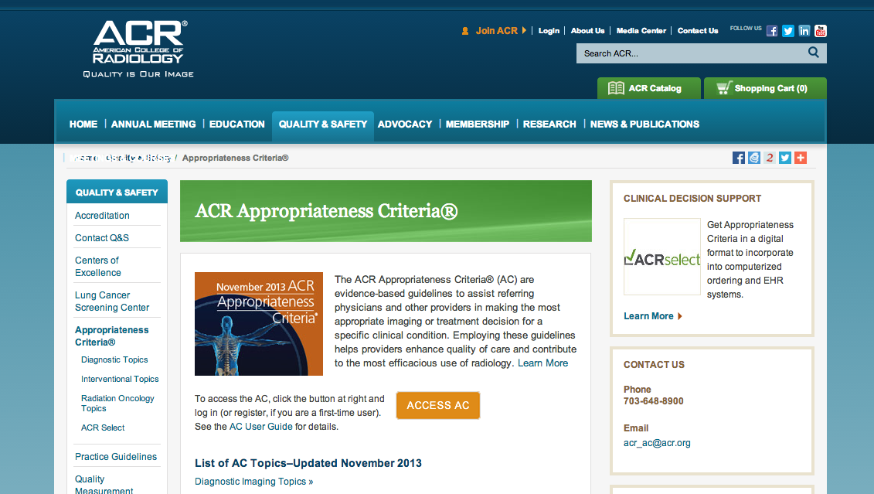
3. Clinical decision support informs treating physicians’ decision making at the point of care
A web-services delivery model brings the Appropriateness Criteria into clinical use.
Appropriateness Criteria
Paper and searchable PDF are useful, but rarely used at the point of care.
A digitized clinically consumable format allows integration into EHRs.
All the work that went into developing the AC is reaching its potential in informing better patient care.
Notes:
Clinical decision support informs treating physicians’ decision making at just the right time - at the point of care. The delivery of the ACR Appropriateness CriteriaTM has progressed over my 25 year career from a giant ring binder to a compact disc and then to searchable web based product, but our preferring physicians only rarely used them at the point of care. ACR SelectTM, a digitized clinically consumable decision support tool, provides a digital web based delivery solution that integrates clinical decision support into order entry and brings the Appropriateness CriteriaTM into clinical use at the point of care, and with integration into electronic health record (EHR) products, there is potential for widespread adoption. Interacting with the EHR will be requisite for ordering physicians and providing appropriate use guidance when they enter the reason for the examination provides the best workflow solution.

Slide 15

3. Clinical decision support informs treating physicians’ decision making at the point of care
The widespread use of CPOE, and the integration of the AC into EHR supports adoption.
Some institutions may choose to add another layer to provide utility beyond the EHR, but eventually all orders will have to flow through the EHR to be valuable.
CDS increases the relevance of radiologists at the point of care.
Notes:
Clinical decision support informs treating physicians’ decision making at just the right time - at the point of care. The delivery of the ACR Appropriateness CriteriaTM has progressed over my 25 year career from a giant ring binder to a compact disc and then to searchable web based product, but our preferring physicians only rarely used them at the point of care. ACR SelectTM, a digitized clinically consumable decision support tool, provides a digital web based delivery solution that integrates clinical decision support into order entry and brings the Appropriateness CriteriaTM into clinical use at the point of care, and with integration into electronic health record (EHR) products, there is potential for widespread adoption. Interacting with the EHR will be requisite for ordering physicians and providing appropriate use guidance when they enter the reason for the examination provides the best workflow solution.

Slide 16
4
Clinical decision support increases the relevance of radiologists to ordering physicians and the health system.
1
2
3
4
5
Notes:
4. Clinical decision support increases the relevance of radiologists to ordering physicians and the health system.

Slide 17

Exams may still be ordered without radiologist involvement, but low appropriateness scores drive ordering physicians to engage in consultation with a radiologist, increasing visibility and value.
CDS provides an appropriateness score for every examination; these data are the basis for analytics of inappropriate ordering allowing education of ordering physicians.
Notes:
Clinical decision support increases the relevance of radiologists to ordering physicians and the health system. While a large majority of examinations will be ordered without involvement of radiologists, orders generating low appropriateness scores could trigger a consultation with a radiologist. These interactions allow radiologist intervention at the appropriate time and will increase radiologists’ visibility and value to their health systems. Since decision support systems provide an appropriateness score for every examination, these data can be the basis for analytics that will help understand causes for inappropriate utilization, and radiologists can be associated with the education efforts to improve ordering physician performance. Nationally, policy makers will see radiology as part of the solution not part of the problem, and that may positively impact our ability to maintain reimbursement in the fee for service system.

Slide 18
4. Clinical decision support increases the relevance of radiologists to ordering physicians and the health system
Nationally, radiology will be seen by policy makers as part of the solution not part of the problem.
No matter how good everything else is, if the reason for doing an exam is inappropriate, there is no value.
Value
Appropriateness x Outcome
Cost
Notes:
Clinical decision support increases the relevance of radiologists to ordering physicians and the health system. While a large majority of examinations will be ordered without involvement of radiologists, orders generating low appropriateness scores could trigger a consultation with a radiologist. These interactions allow radiologist intervention at the appropriate time and will increase radiologists’ visibility and value to their health systems. Since decision support systems provide an appropriateness score for every examination, these data can be the basis for analytics that will help understand causes for inappropriate utilization, and radiologists can be associated with the education efforts to improve ordering physician performance. Nationally, policy makers will see radiology as part of the solution not part of the problem, and that may positively impact our ability to maintain reimbursement in the fee for service system.

Slide 19
5
There are value scenarios for radiologists who embrace clinical decision support in both accountable care and FFS payment systems.
1
2
3
4
5
Notes:
5. There are value scenarios for radiologists who embrace clinical decision support in both accountable care and fee for service payment systems.

Slide 20
5. There are value scenarios for radiologists who embrace clinical decision support in both accountable care and fee-for-service payment systems
Accountable Care & Capitation
There are value scenarios for radiologists who embrace clinical decision support in both accountable care and FFS payment systems.
Fee-for-service
Value-based
systems & solutions
$
UM is valuable and necessary and if run by radiologists it could be a significant source of revenue.
Notes:
There are value scenarios for radiologists who embrace clinical decision support in both accountable care and fee for service payment systems. Payment models are transforming from fee for service to value-based systems, and whether we like it or not, imaging reimbursement will not be immune to this transition. In accountable care (capitation) models, utilization management is a valuable and necessary element of the program, and if run by radiologists using robust decision support tools, utilization management could be a source of revenue for radiologists as well. Managing imaging utilization gives radiologists a seat the table with a value-based solution for the health system. At the same time, fee for service payment models will likely be around for some time to come. In fee for service radiologists must understand that in a world driven by consumerism, if there is no value there will be no volume. If one considers the following value equation where VI is the value of an imaging study:
VI = Appropriateness * Outcome /Cost
no matter how good everything else is, if the reason for doing an exam is inappropriate, there is no value. Those radiologists who are committed to value will have an inherent advantage over those that are not, and perhaps more importantly timely accurate interpretations, while requisite, will not be the sole measure of our value. Value based payments in the Physician Quality Reporting System (PQRS) or Meaningful Use of Information Technology may become available but are not a panacea. Opportunities on a
larger scale may come from radiologists working with the non-Medicare payers where savings generated form radiologist managed imaging utilization programs are shared with the radiologists. By implementing clinical decision support tools before moving to risk sharing payment models, radiologists will be able to collect data that will inform their move to population-based and risk sharing payment systems. While I think all of us hope that the next Congress will be able to find a way to reform the SGR formula, it is good to know that there is now a precedent for enacting meaningful healthcare provisions even when Congress cannot agree on a permanent solution to reforming the SGR. Aligning incentives is key for healthcare reform to work, and establishing the clinical decision support model for imaging in the Medicare program is a step in the right direction. Wide adoption of clinical decision support will be the best way to for us prevent additional fee for service payment cuts for imaging as we transition to other payment models.

