Slide 1
Understanding the Patient’s Perception – Imaging 2.0 vs. Imaging 3.0
Patient’s Perception [Imaging 2.0]
Patients have limited interaction with Imaging 2.0 radiologists and don’t know (or care) about the workflow details that prevent them from getting their results in a timely fashion.
!
Radiologists are disconnected from the patient experience and only focus on getting their piece of the work done.
Referring Physician Consult
Decision to Call
Call to Schedule
Schedule to Exam
Exam to Dictate
Dictate to Transcribe
Transcribe to Signed
Results Available
REFERRING PHYSICIAN
PATIENT
PATIENT
PATIENT
RADIOLOGIST
RADIOLOGIST
RADIOLOGIST
PATIENT
PATIENT

Slide 2
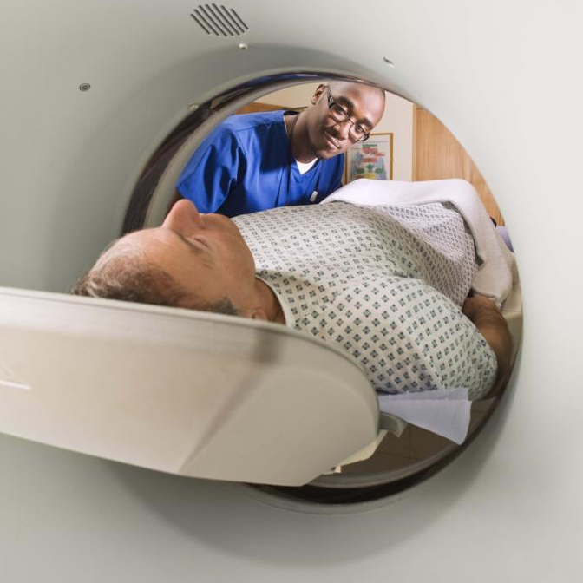

Understanding the Patient’s Perception – Imaging 2.0 vs. Imaging 3.0
Ideal Measure [Imaging 3.0]
Imaging 3.0 radiologists are “present” from the time a test is considered until the results are delivered in a meaningful and actionable report and next steps are being taken appropriately.
Referring Physician Consult
Decision to Call
Call to Schedule
Schedule to Exam
Exam to Dictate
Dictate to Transcribe
Transcribe to Signed
Results Available
REFERRING PHYSICIAN
PATIENT
PATIENT
PATIENT
RADIOLOGIST
RADIOLOGIST
RADIOLOGIST
PATIENT
PATIENT
RADIOLOGIST
RADIOLOGIST
RADIOLOGIST
PATIENT
PATIENT
PATIENT
RADIOLOGIST
RADIOLOGIST
REFERRING PHYSICIAN

