Slide 1




Mapping Possibilities
An Imaging 3.0 Case Study
January 30, 2019
These slides are disseminated to our respective members as a partnership of:

Slide 2

Syed F. Zaidi, MD
Vice President of Clinical Operations
Radiology Partners
Medical Director of Co-Management
Imaging Service Line
Aultman Hospital

Slide 3

Imaging 3.0 Case Study Video

Slide 4
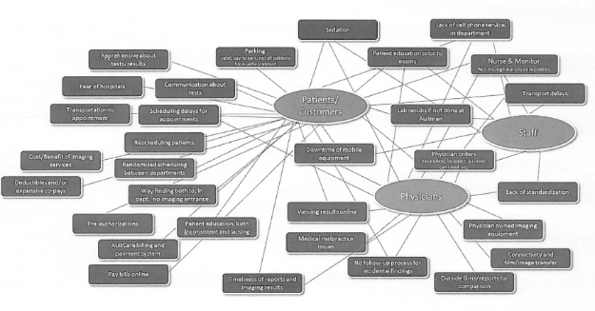
Altman Hospital's Hassle Map
Notes:
The tool examines the challenges that medical staff face when interacting with services, systems, and products.
Helps medical professionals, including radiologists, improve their workflow and increase patient satisfaction.
The map includes three groups — patients, physicians, and staff — and the hassles are arranged around the groups with lines connecting each group to the hassles it encounters.
Radiology leaders began working with their radiology colleagues, technologists, staff, and referring providers to identify the group’s hassles — including everything from scheduling delays to lack of standardization.

Slide 5
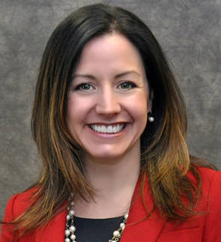
What & Impact
An American College of Radiology Imaging 3.0 Case Study
Partnership
Success in identifying and addressing hassles involved radiologists, hospital administrative staff, referring physicians and patients.
If you want to know what’s wrong…. Ask!
Building on trusted relationships, ask your customers/users about what they like about interacting with you, and what could be improved.
If they tell you that something’s wrong…. Fix it!
Once you ask your customers what needs to be fixed, you have set the expectation that you will try to fix the issue(s).
Communicate back what you learned and continue to communicate your priorities, schedule and progress towards addressing the issues.
Do-It-Yourself Process and Quality Improvement
This kind of activity can be driven by a passionate team without necessarily requiring a large budget or highly-trained consultants.
Kristen M. DeDent, executive director of process improvement at Aultman Hospital, implemented the hassle map project across the hospital.
Notes:
Kristen M. DeDent, executive director of process improvement at Aultman, initiated the hassle map project across the hospital, rolling it out to radiology, surgery, and pharmacy first.
To start, DeDent met one-on-one with the leaders of each care collaborative (also known as service lines) to teach them about hassle maps and instruct them how to leverage the tools with their teams.
DeDent left it up to the leaders of each care collaborative to determine how to engage their teams and others to identify the hassles in their respective service areas.
Developing a hassle map is basically brainstorming to think of all of the places that patients and others might get hung up as they move through your system. This is something anyone can do.
Radiology leaders held meetings with the physicians, technologists, and staff on each shift within the department and also sent emails seeking input.
The team also reached outside of the department through emails, phone calls, and in-person meetings to include feedback from referring providers.
Through this process, they identified more than two dozen hassles, from challenges associated with parking and obtaining lab results to an inadequate number of nurses within the department and insufficient patient education prior to exams.
Once DeDent completed the map, the co-management team comprising radiology and hospital leaders met to prioritize short- and long-term solutions to the hassles, with those directly affecting patients receiving top priority.

Slide 6
Discussion Topics for Your Team
Have you tried to understand the experience of using radiology in your organization from the “other side” (i.e., patients and referring physicians)? Do you know what hassles are involved in these interactions with your team?
Have you built the trust with your health system and referring physicians to have an honest conversation about “hassles” that you can fix?
If you do identify hassles, are you prepared to take the action to resolve them, so that you both help and build trust with your customers who took the time to provide you with honest feedback?
Does your health system have quality/process improvement experts who can support/coach you with this type of effort?

Slide 7
Actionable Items for Your Team
Study the Hassle Map materials and socialize them with your radiology team at an all-staff meeting.
Share this case study and initiate a conversation with the QI/PI staff at your health system.
When you interact with patients and referring physicians, ask them about their experience. Share the results with your team.

Slide 8
Implement Your Own Program
Based on your post-case group discussion and brainstorming, identify one way your team can implement Imaging 3.0 principles in your practice.
After implementation, submit your program for consideration as an Imaging 3.0 Case Study: https://www.acr.org/Practice-Management-Quality-Informatics/Imaging-3

Slide 9
Learn More About The Mapping Possibilities Case Study
The Written Case Study: https://www.acr.org/Practice-Management-Quality-Informatics/Imaging-3/Case-Studies/Strategic-Planning/Mapping-Possibilities
The Art of Hassle Map Thinking: https://changethis.com/manifesto/86.01.Demand/pdf/86.01.Demand.pdf
Aultman Hospital’s completed Hassle Map: https://www.acr.org/-/media/ACR/NOINDEX/Case-Study-Materials/Aultman-Radiology-Hassle-Map.pdf?la=en
The ACR Patient- and Family-Centered Care Commission: https://www.acr.org/Practice-Management-Quality-Informatics/Patient-Family-Centered-Care

Slide 10
Appendix of Additional Resources

Slide 11






Read 100+ other ACR Imaging 3.0 Case Studies
ACR has 100+ Imaging 3.0 Case Studies that fall under the six categories below. Click each category to learn more:

Slide 12
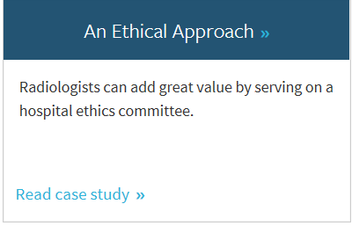
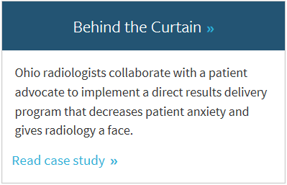
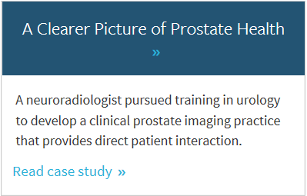
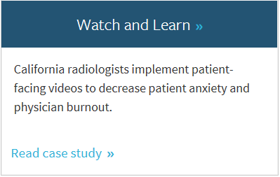
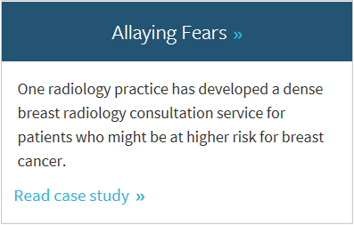
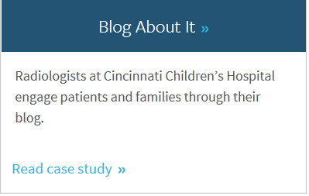
Imaging 3.0 Case Studies about Patient Engagement
For example, the Patient Engagement category features 20+ Imaging 3.0 Case Studies for further learning, including the 6 featured below:

Slide 13

Making the Connection Between Imaging 3.0 Case Studies and the Imaging Value Chain
An American College of Radiology Initiative

Slide 14
Imaging 3.0 Cases Demonstrate the Value Chain in Your Organization
Case Studies
Imaging Value Chain
The ACR’s Imaging 3.0 initiative is designed to help radiologists shape their future using tools and processes to improve practice management and patient care.
Connection Point
The JACR’s Imaging Value Chain is a series of peer-reviewed articles based on the five Imaging 3.0 pillars to help transition the practice of radiology from volume-based to value-based imaging care.
Practical, straight forward success stories you can use to implement improvements in your patient care and practice management today.

Slide 15
Learn More about Imaging 3.0 and The Imaging Value Chain
A series of 7 articles from the Journal of the American College of Radiology (JACR) describe the Imaging Value Chain.
TAKE ACTION: You and/or your team can make a connection between the topics raised in this Imaging 3.0 Case Study and the Imaging Value Chain by focusing on articles #2 and #6.
Overview of the Imaging Value Chain
#1 - Delivery of Appropriateness, Quality, Safety, Efficiency and Patient
#2 - Appropriateness, Scheduling, and Patient Preparation
#3 - Protocol Design and Optimization
#4 - Optimizing Modality Operations
#5 - Actionable Reporting
#6 - Communication of Actionable Information
#7 - Business Intelligence, Data Mining, and Future Trends

Slide 16
Thank You
If you have questions, please contact Chris Hobson:
chobson@acr.org
These slides are disseminated to our respective members as a partnership of:

Slide 17
License
This case study by American College of Radiology is licensed under a Creative Commons Attribution NonCommercial-NoDerivatives 4.0 International License
Based on a work at www.acr.org
Permissions beyond the scope of this license may be available at www.acr.org/Legal

