Slide 1




Ahead of the Curve
Early adopters of Clinical Decision Support deliver more appropriate imaging and help ordering physicians prepare for
PAMA legislation’s impact on reimbursement.
An Imaging 3.0 Case Study
July 31, 2018
These slides are disseminated to our respective members as a partnership of:

Slide 2

If you experience troubles playing the video, please copy and paste the following URL into your browser: https://www.youtube.com/watch?v=kirrgYcl6Ro&feature=youtu.be

Slide 3

What & Impact
An American College of Radiology Imaging 3.0 Case Study
Alignment
  Radiology leadership saw CDS as a way to improve the quality of imaging ordering, as well as prepare for future reimbursement requirements (i.e., PAMA)
Socialization with Key Stakeholders
  Radiology leadership approached leaders of other specialties at the hospital, like ED, to see if they would take part in the pilot.
Iterative Pilot Testing
  Prepared video to help explain CDS to new recruits
  After a first round of testing, expanded to more departments and more physicians within each department
  Review data on appropriate ordering before and after
Solicit and Incorporate Feedback
  Collaborated with vendor of CareSelect to incorporate PECARN guidelines as a supplement to AC guidelines in CDS system
Ryan K. Lee, MD, MBA, section chief of neuroradiology, is spearheading an incremental pilot project to integrate CDS into the EMR at Einstein Healthcare Network in Philadelphia.

Slide 4
Discussion Topics for Your Team
Who is driving the CDS rollout in your organization ahead of the 2020 PAMA deadline? Are there radiologists involved in or leading the team? Why or why not?
Will your organization’s CDS rollout happen in stages, obtaining buy-in and feedback to be incorporated at each stage?
What clinical guidelines are the highest priority for your ordering physicians? Based on the data, where is the potentially biggest impact from CDS on ordering habits?
What could impede the success of your organization’s CDS rollout? How can those risks be mitigated?

Slide 5
Implement Your Own Program
Based on your post-case group discussion and brainstorming, identify one way your team can implement Imaging 3.0 principles in your practice.
After implementation, submit your program for consideration as an Imaging 3.0 Case Study: https://www.acr.org/Practice-Management-Quality-Informatics/Imaging-3

Slide 6
Learn More About The Ahead of the Curve Case Study
The Written Case Study: https://www.acr.org/Practice-Management-Quality-Informatics/Imaging-3/Case-Studies/Information-Technology/Ahead-of-the-Curve
The 5 Minutes Video of This Case Study: https://www.youtube.com/watch?v=kirrgYcl6Ro&feature=youtu.be
A webinar featuring Dr. Lee from Einstein Healthcare Network in “A Round Table Discussion on Implementing Enterprise-wide CDS Solutions.” Register here to access the recording: http://cds.nationaldecisionsupport.com/lets-talk-it-webinar-recording
The ACR Patient- and Family-Centered Care Commission

Slide 7
Appendix of Additional Resources

Slide 8






Read 100+ other ACR Imaging 3.0 Case Studies
ACR has 100+ Imaging 3.0 Case Studies that fall under the six categories below. Click each category to learn more:

Slide 9
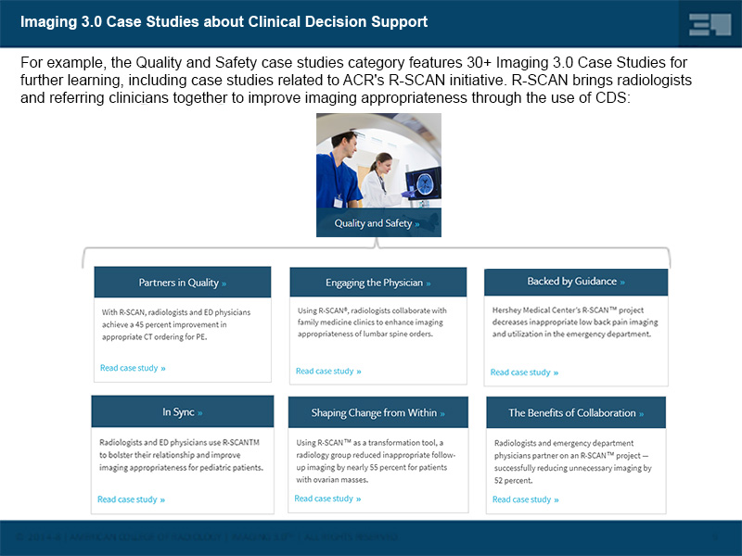

Slide 10

Making the Connection Between Imaging 3.0 Case Studies and the Imaging Value Chain
An American College of Radiology Initiative

Slide 11
Imaging 3.0 Cases Demonstrate the Value Chain in Your Organization
Case Studies
Imaging Value Chain
The ACR’s Imaging 3.0 initiative is designed to help radiologists shape their future using tools and processes to improve practice management and patient care.
Connection Point
The JACR’s Imaging Value Chain is a series of peer-reviewed articles based on the five Imaging 3.0 pillars to help transition the practice of radiology from volume-based to value-based imaging care.
Practical, straight forward success stories you can use to implement improvements in your patient care and practice management today.

Slide 12
Learn More about Imaging 3.0 and The Imaging Value Chain
A series of 7 articles from the Journal of the American College of Radiology (JACR) describe the Imaging Value Chain.
TAKE ACTION: You and/or your team can make a connection between the topics raised in this Imaging 3.0 Case Study and the Imaging Value Chain by focusing on articles #2 and #6.
Overview of the Imaging Value Chain
#1 - Delivery of Appropriateness, Quality, Safety, Efficiency and Patient
#2 - Appropriateness, Scheduling, and Patient Preparation
#3 - Protocol Design and Optimization
#4 - Optimizing Modality Operations
#5 - Actionable Reporting
#6 - Communication of Actionable Information
#7 - Business Intelligence, Data Mining, and Future Trends

Slide 13
Thank You
If you have questions, please contact Chris Hobson:
chobson@acr.org
These slides are disseminated to our respective members as a partnership of:

Slide 14
License
This case study by American College of Radiology is licensed under a Creative Commons Attribution NonCommercial-NoDerivatives 4.0 International License
Based on a work at www.acr.org
Permissions beyond the scope of this license may be available at www.acr.org/Legal

