Slide 1

What is Imaging 3.0 and how is it going to be Radiology’s Escape Fire?

Slide 2
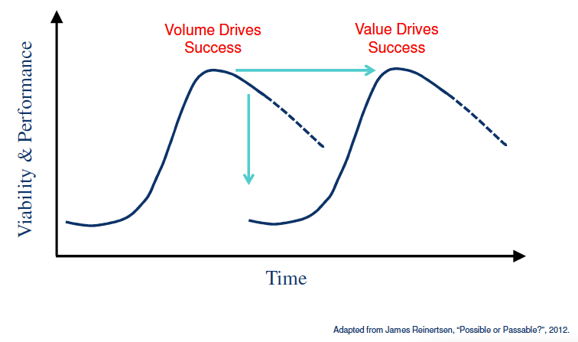
Imaging 2.0
Imaging 3.0

Slide 3
Imaging 3.0 is Radiology’s Roadmap for the transition from volume-based imaging to value-based imaging care

Slide 4

Productivity
Presence

Slide 5
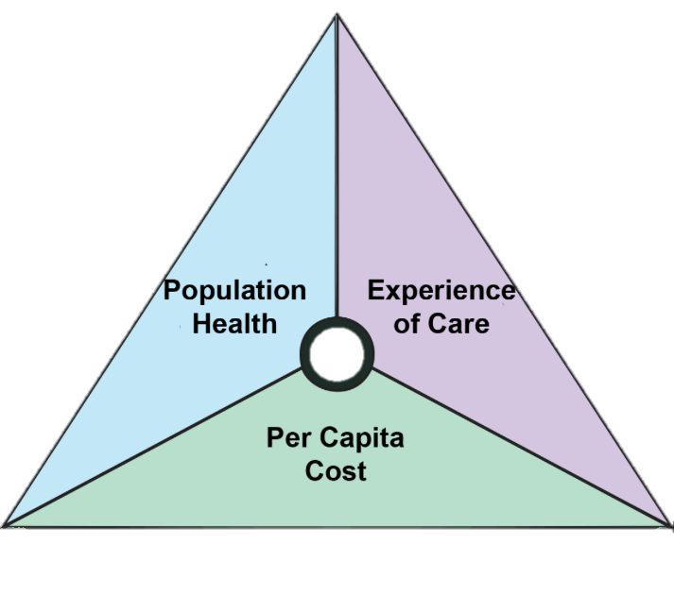

Slide 6
Is imaging part of the problem?
Imaging 3.0:Demonstrating that imaging is a high value solution

Slide 7
Imaging 3.0
What is it?
Practice model
Toolkit for making the transition to Value-Based Care
Advocacy tool for policy makers to align incentives
Basis for empowering patients
Who is it for?
Radiologists
Referring physicians
Patients
Policy makers

Slide 8
Imaging 3.0
What does it do?
Leverages IT
Redefines productivity and value
Establishes relationships
Where does it fit?
Systems
Radiologist Relevance
Patients

Slide 9
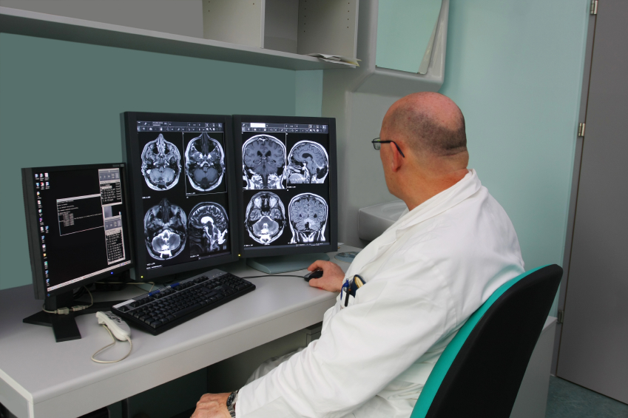
Imaging 2.0 focuses on the interpretation
Good but no longer good enough
Notes:
Incentives for optimal care lacking
For radiologists and For referring physicians
Unnecessary imaging continues
When recent prior imaging is unavailable
When evidence-based appropriateness criteria are not followed
At the time of order entry
At time of interpretation
Results
Suboptimal care
Higher costs
Higher radiation dose

Slide 10






Imaging 3.0 – beyond the interpretation
_{Referring Physician}
_{Considers Imaging}
Imaging History Reviewed in PHR
Appropriateness Criteria Consulted
Appropriate Imaging Ordered
_{Radiation Safety} _{Considered}

Slide 11
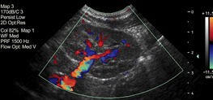




Imaging 3.0 – beyond the interpretation
Actionable Recommendations For The Patient And Referring Physician
_{Decision Support for}
_{Results Reporting}
_{Media Rich}
_{Actionable Reporting}
Meaningful, Actionable Reporting For Referring Physicians and Patients
_{Registry Reporting}

Slide 12




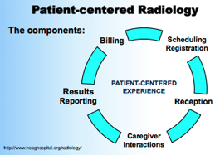



Imaging 3.0: Putting Patients First and proving it
_{Imaging Acquisition}
_{& Interpretation}
_{Imaging Acquisition}
_{& Interpretation}
_{Registry Reporting}
_{Board Certified Radiologists}
_{Engage in Lifelong Learning}
Through Maintenance of Certifications
_{PQRS}
Empowering
Patients
Enhancing Patients’
Experiences
Demonstrating Quality / safety

Slide 13


Imaging 3.0 – tools at the point of care
_{Decision Support for}
_{Results Reporting}
_{Registry Reporting}
_{PQRS}

Slide 14



Under the Imaging 3.0 Umbrella
_{Referring Physician}
_{Considers Imaging}
_{Imaging Acquisition}
_{& Interpretation}
Actionable Recommendations For The Patient And Referring Physician
Imaging History Reviewed in PHR
_{Imaging Acquisition}
_{& Interpretation}
_{Decision Support for}
_{Results Reporting}
_{Appropriateness Criteria}
_{Consulted}
_{Media Rich}
_{Actionable Reporting}
_{Board Certified Radiologists}
_{Engage in Lifelong Learning}
Through Maintenance of Certifications
_{PQRS}
_{Registry Reporting}

Slide 15
Will all these Imaging 3.0 tools make me more relevant or will they render me obsolete?

Slide 16






Slide 17
Why Imaging 3.0?
“It is not the strongest of the species that survives, nor the most intelligent, but the one most responsive to change.”
Charles Darwin
“Physicians who ‘get it’ will prove extremely disruptive to those who do not.”
Richard Afable
“If you don’t like change,
you’ll like irrelevance even less”
Eric Shinseki

Slide 18
What is the ACR doing to help me manage this change?

Slide 19





Imaging 3.0 – Aligning Incentives
No current incentives to reduce volume in fact in most cases traditional productivity may decrease
No current reward for the work of assuring only appropriate care is provided
Not all practices will be ready at the same time
Not all systems will be ready at the same time
Radiology’s Voice In Washington

Slide 20
What if we’re wrong?
Notes:
If we had $30 million in the Pac then we could think about a different approach
Also advocating for Imaging 3.0 and incentives to reward it does not negate our efforts on Fee for Service in fact it is the thing that opens the door right now

Slide 21


Slide 22
Imaging 3.0: what does success look like?
For Patients
Access and convenience without payer-imposed steerage
Education about the procedure including risks and alternatives
Understanding imaging results and personal consultations
Portable imaging record to empower patients in decision making
For Referring Physicians
Transparent and educational decision support without added costs
Shared imaging information to prevent duplicate care
Precise, reproducible and relevant results reporting
Evidence-based guidelines for follow-up recommendations

Slide 23
Imaging 3.0: what does success look like?
For Radiologists
Integration into the full spectrum of patient care
Confidence in evidence-based recommendations
Professional satisfaction
Relevance and longevity for our specialty

Slide 24
Imaging 3.0
Maximizing radiologists’ value
Collaborating with other physicians
Empowering patients
Changing the discussion in Washington

Slide 25
Imaging 3.0?
I’m already there
I’m on board but anxious
I’d rather take my chances with the fire

