Slide 1

Medical Imaging
Evolution in Patient Care

Slide 2


Medical Imaging
Evolution in Patient Care

Slide 3








Slide 4


Medical Imaging
Evolution in Patient Care

Slide 5
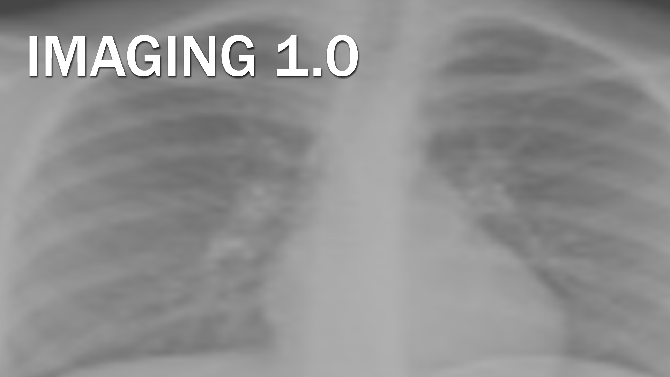
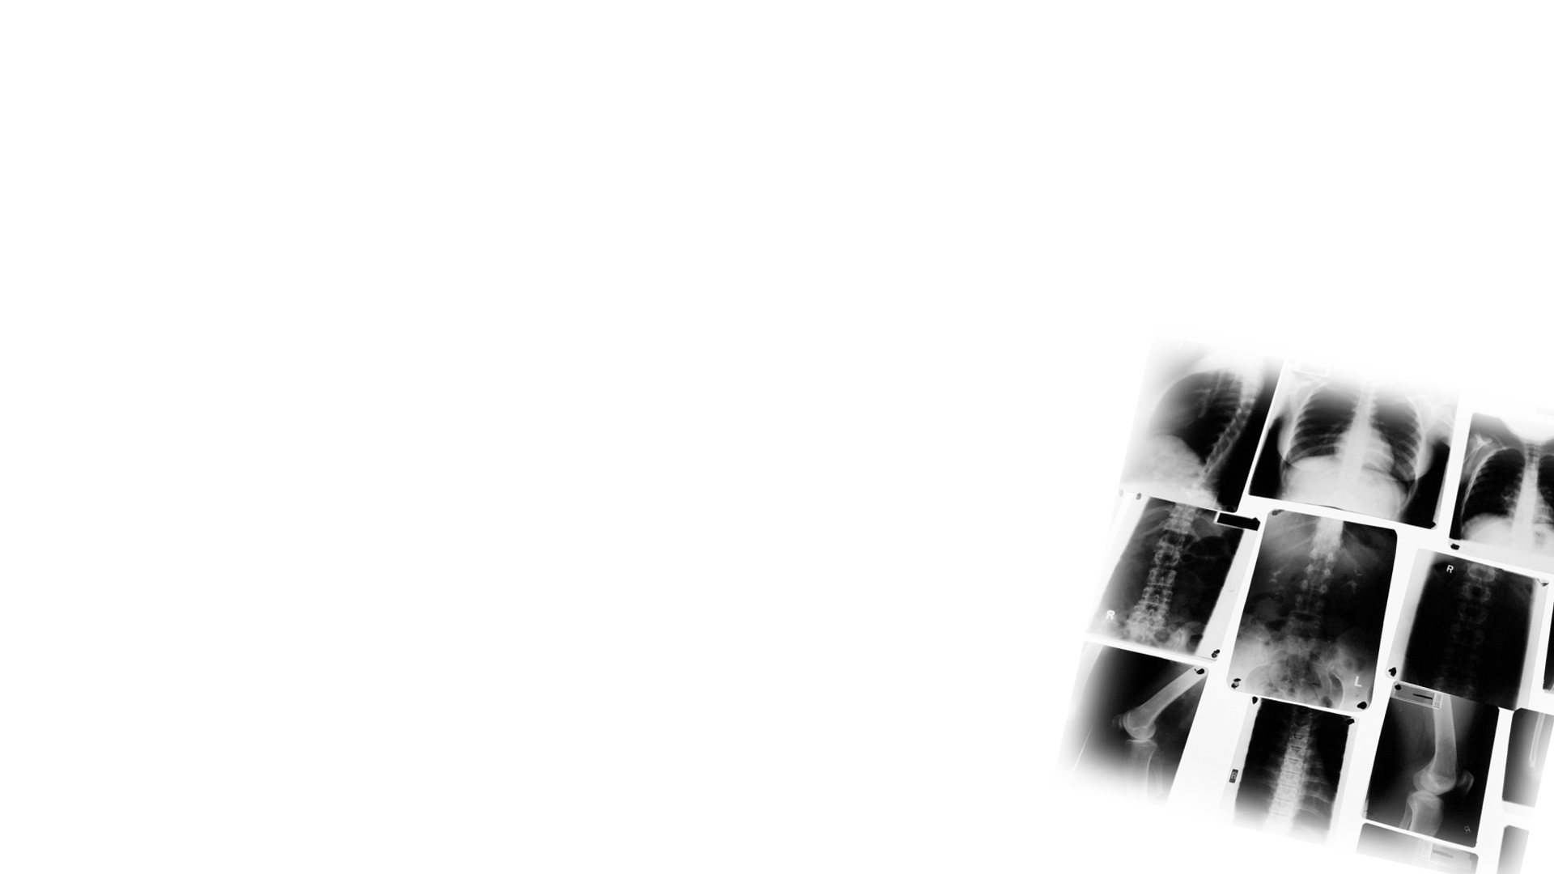

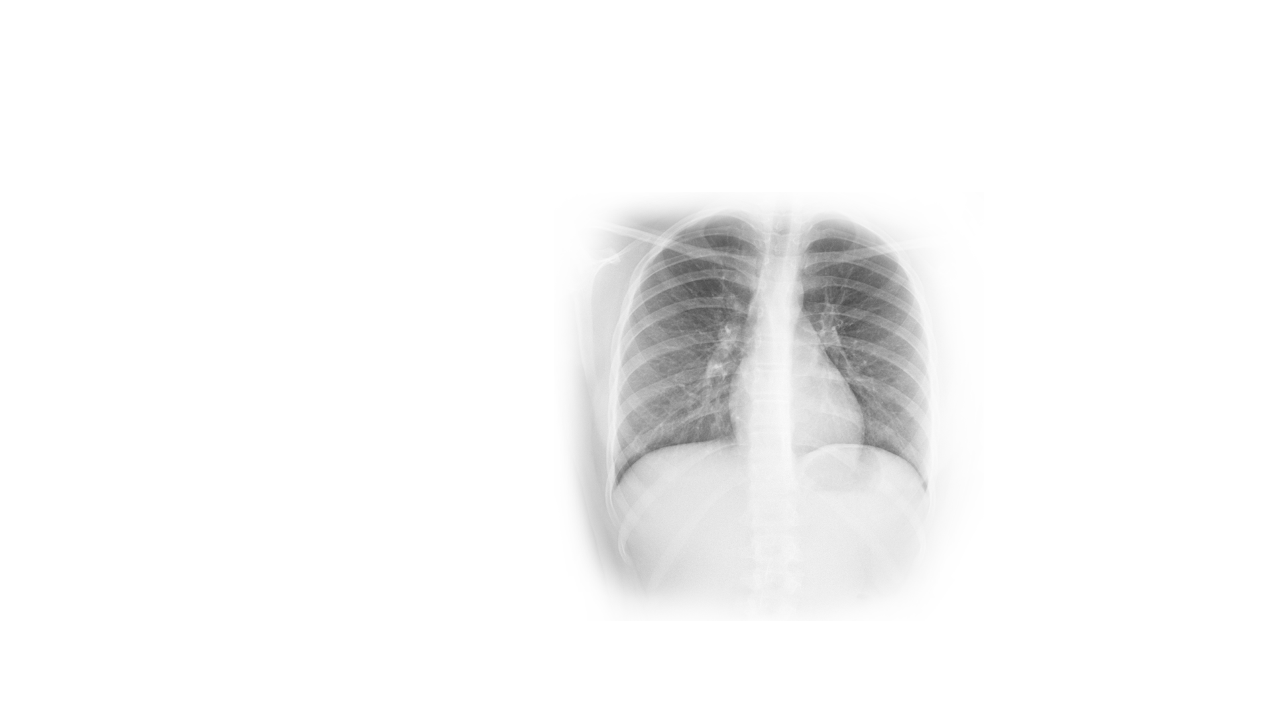

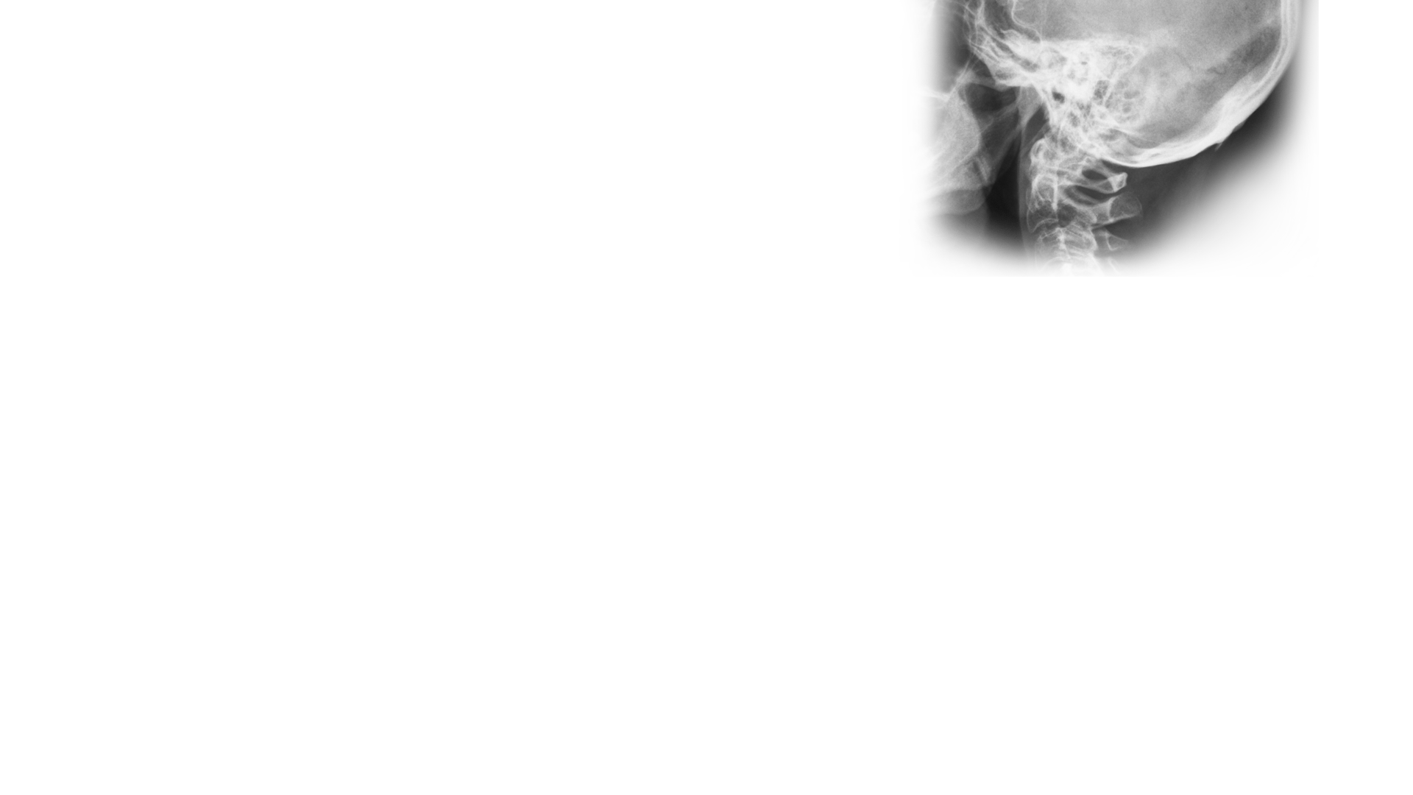


• Physicians
• Contrast Agents
• New Modalities

Slide 6


Medical Imaging
Evolution in Patient Care

Slide 7






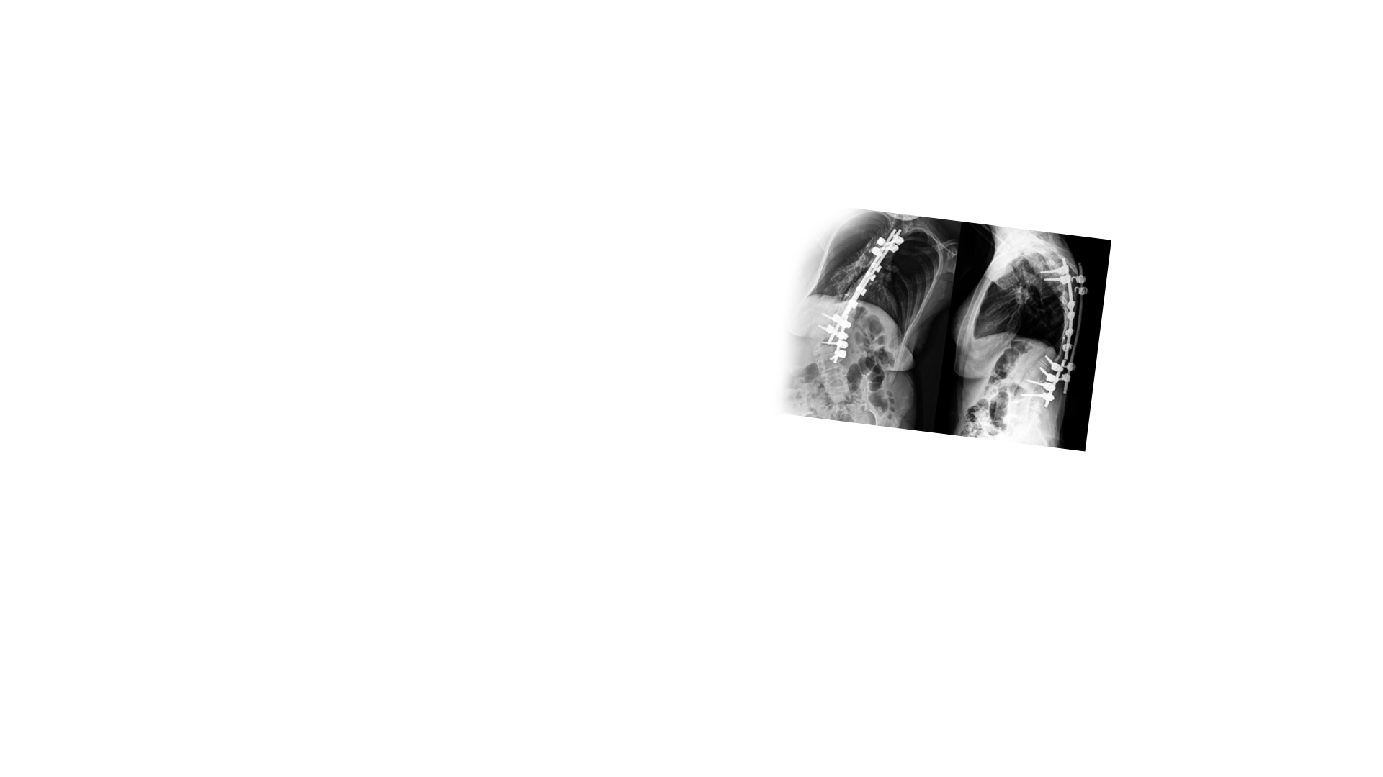

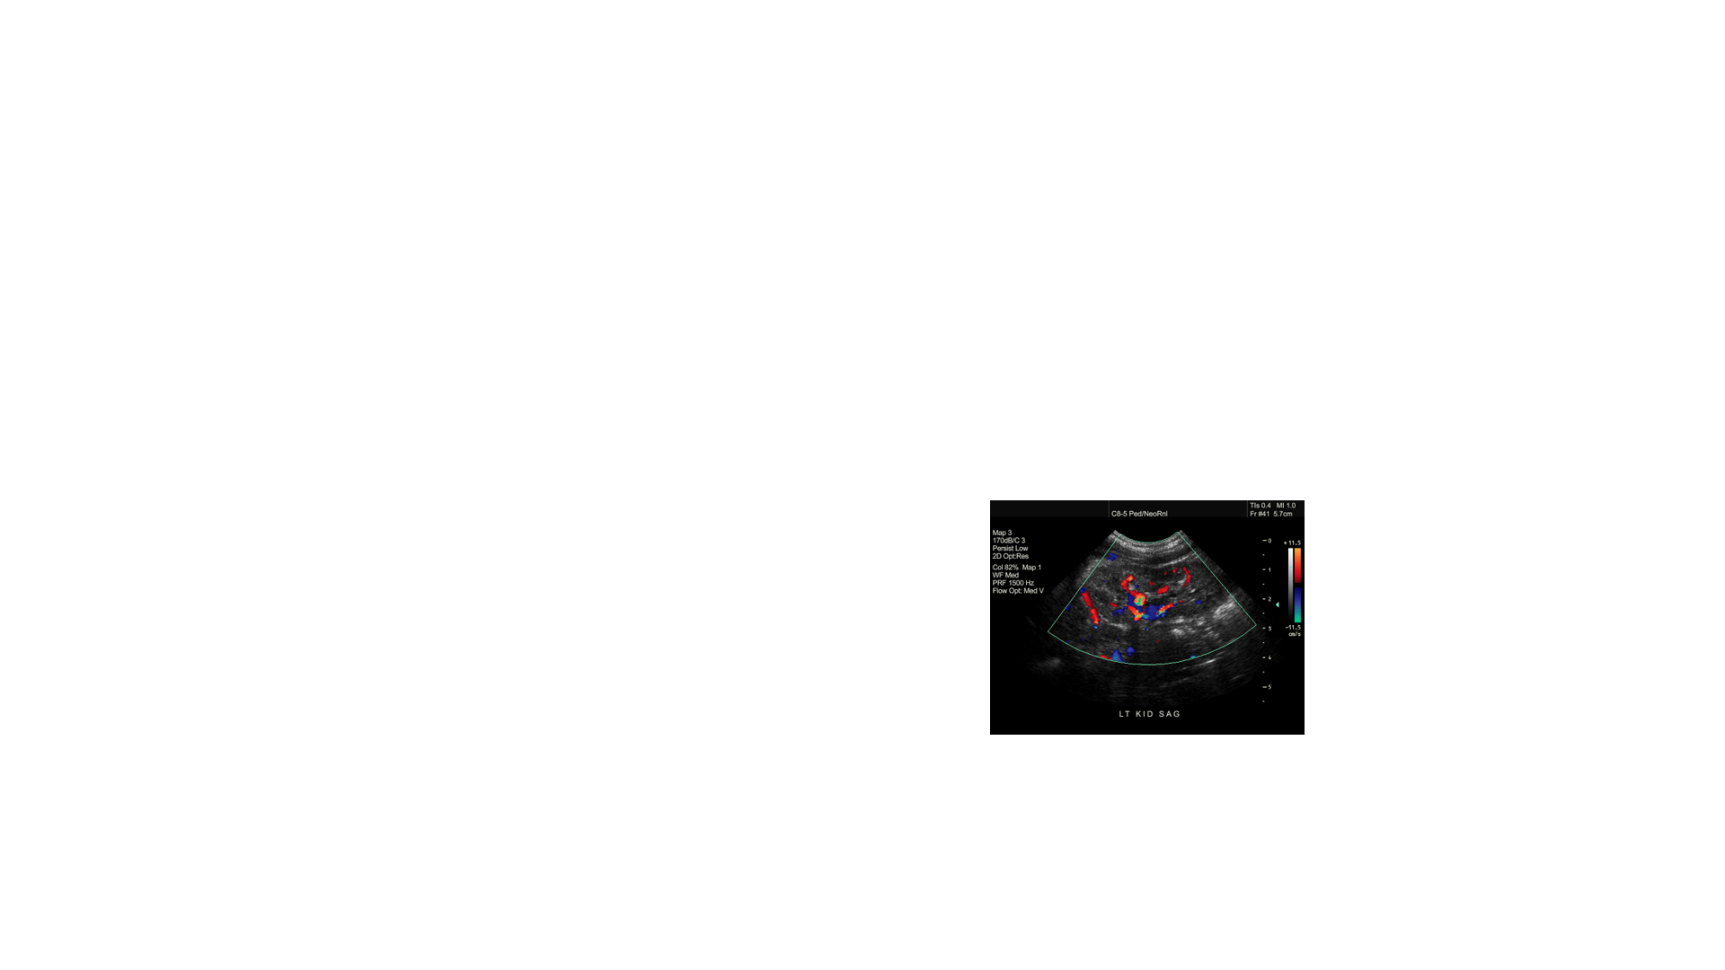


• Evolving Modalities
• PACS
• Knowledge Base
• Consultant to Referring Physicians
• Unprecedented Demand

Slide 8


Medical Imaging
Evolution in Patient Care

Slide 9







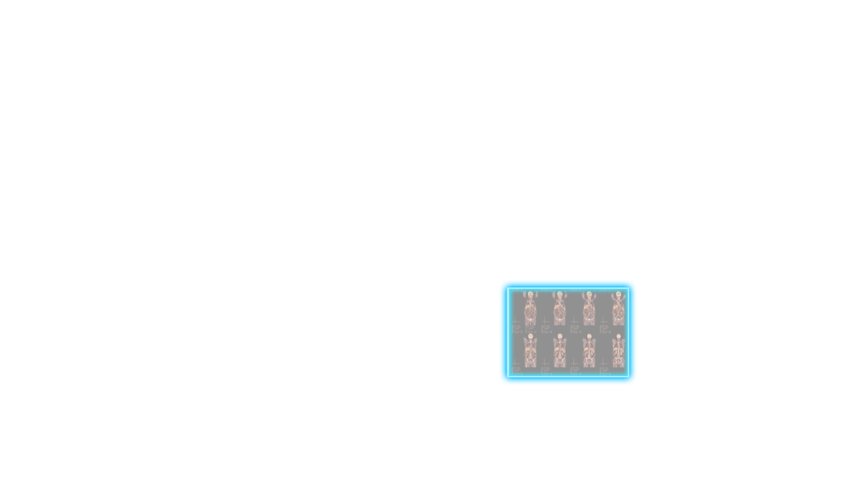



• Beyond Interpretations
• System Integration
• Empowered Patients

Slide 10


Slide 11

Leveraging radiologists’ tools and expertise to optimize patient care from the time imaging is first considered until referring physicians and patients fully understand the imaging results and recommendations

Slide 12
• Maximizing Radiologists’ Value
• Collaborating with Other Physicians
• Empowering Patients
• Changing the Discussion in Washington

