Slide 1

COVID-19
and Your
Radiology
Practice
Material presented reflect the best available experience and knowledge about COVID-19 as of April 7, 2020, and may need to be updated as more information becomes available.

Slide 2
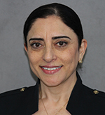
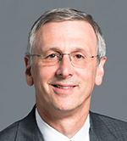
Sabiha Raoof, MD
Practice location: Jamaica and Flushing Hospital Medical Centers, New York

Slide 3
Case triage for deferral
Which conditions made the list? How was the decision implemented?
Staff rotations vs. physician redeployment
Setting a staffing strategy to minimize cross infection, respond to health system needs, and prioritize physician wellness
Revenue Concerns
Preparing for near-term revenue crunch and post-COVID deferred demand

Slide 4
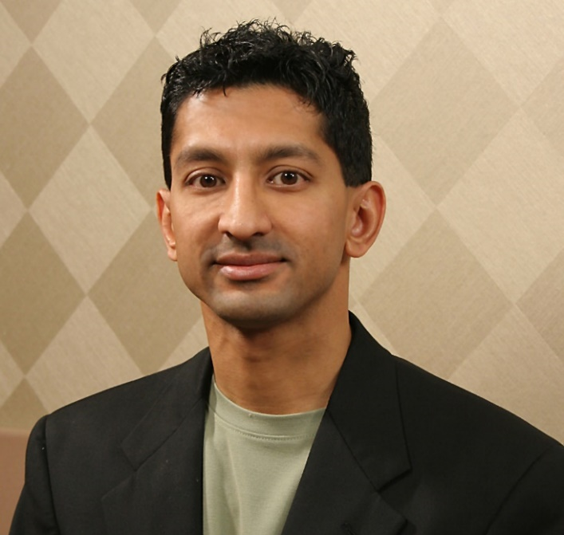
Samir B. Patel, MD, FACR
Radiology, Inc. Value Management Program Director and Executive Board Member; Beacon Health System Board of Directors
Practice type: Independent Private; Diagnostic & Interventional Radiology
Practice location: North Central Indiana (Mishawaka, IN; 3 Hospital Systems and Multiple Outpatient Centers)
Practice size: 39 radiologists
Practice model: Partnership; Multispecialists and Subspecialists; Internal billing operations and staff

Slide 5
Radiology workforce deployment and preparedness for
cross-discipline coverage
Involvement of Human Resources Committee (HRC), Department Chairs and Vice-Chairs, Executive Board (leadership crucial)
Home workstations (limited supply) deployed for radiologists with potential risk factors for COVID-19 and several back-up for individuals who may become quarantined (coordination of practice network engineers and hospital IT associates)
Engagement with client leadership on rescheduling and batching imaging exams (adjusting demand) which then can lead to radiologist supply adjustments
Block scheduling of radiologists by site, service line, and reading rooms on consecutive days
Eliminating same-day reading room switches by radiologists within and between facilities
Practice members completed internal practice and health system surveys about availability and willingness to practice outside of radiology department
“Cross-discipline” coverage could include radiology multispecialization, non-radiologist physician service lines, technologist activities, and leadership positions

Slide 6
Elective exam rescheduling process and implementation
Challenge of multiple hospital systems and non-hospital sites with variable policies
  Oncology imaging and patient management variability across sites
  Communication with client leadership and practice members critical
Radiology action plans parallel health system action plans with radiologist input
  Incident command structure with radiology integral part of at multiple levels
Radiology department chair and vice-chairs critical for department policy input and are the point of contact for external communications
As of 3/21/20, largest health system:
  Indefinitely suspended screening mammograms, DXA, lung screening CT, calcium score CT
  “Stage 3” IR (part of surgery): Cancelled elective surgical procedures unlikely to cause harm if not performed in 1-2 months
  Guidance to centralized scheduling for rescheduling and physician-physician communication if needed
  Batching of exams to certain days of the week; increasing same day breast biopsies
Radiology professional society clinical guidance resources and online radiology forums

Slide 7
Accommodating downstream increased demand after COVID-19
Practice has existing built-in “flex day” capacity (more than 2 decades; culture; discretionary) for work-life balance, volume increases, radiologist shortage (e.g. quarantine)
Year-end staffing model earlier implementation (e.g. breast imaging)
Internal moonlighting
  Additional compensated workshifts during evenings and weekends for increased outpatient exams and outpatient surgeries
  Selling of vacation days
Utilizing multispecialty radiologists across various sites and rotations
Looking forward to the start of newly hired physicians beginning summer 2020

Slide 8
Managing decreased revenue due to COVID-19
Business office team indispensable
Daily monitoring of cash flow projections and reporting to our Executive Board
  Available COVID-19 Impact Worksheet: https://www.linkedin.com/pulse/updated-radiologist-covid-impact-worksheet-now-includes-bohl/?trackingId=xNj%2BTa50%2FS%2Fl8TNTjs9GWg%3D%3D
Currently withholding bonus payments to shareholders
Business office staff continuing work from home; currently preserving staff salaries
Overnight teleradiology service taken in-house (primarily value-add; secondary financial benefit) temporarily
Applied for Payroll Protection Program Loan at Bank Under CARES Act (4/3/20)
Pursuing Medicare Advanced Payments (Accelerated and Advance Payment Program)
Awaiting Details of Public Health and Social Services Emergency Fund
Softening our collection activities
https://www.acr.org/Advocacy-and-Economics/COVID-19-Economic-Updates

Slide 9
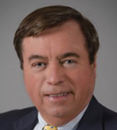
Robert S Pyatt, Jr MD FACR
Chair, Radiology Dept, Wellspan-Summit Health
Practice type: Private. Contracted with Wellspan Health.
Practice location: Chambersburg, PA, a rural location. Cover 2 Hospitals.
Practice size: 11 Rads, 7 FT, 4 PT, 200,000 procedures/year
Practice model: Partnership. I am a Half-Time Partner (Disclosure).
No Other Disclosures.

Slide 10
Radiology workforce deployment and preparedness for cross-discipline coverage
While we have 3 neuro fellows, 1 thoracic fellow, 1 body/IR Fellow, and 1 MSK fellow, they are all generalist/multispecialty radiologists, doing >50% of their time outside their specialty, normally. 5 rads are non-fellowship trained but are strong generalists.
This allows strong cross discipline coverage. telerad specialty coverage available 24x7 when needed, 7 days/week. Sharp decline in day/night usage during COVID.
All FT rads equipped in advance with home PACS.
Rads at higher risk (age, immunosuppressed, etc.) are pure telerad or very minimal hospital role, until COVID over. May work in outpatient center, which has tight screening & diversion to open air tents.
Most PT staff on planned vacation, temporary leave, or transferred vacation weeks.

Slide 11
Elective exam rescheduling process and implementation
All elective or non-acute cases have been rescheduled, beginning the week of May 4th. System-wide uniform process for rescheduling.
Today, April 7, PA governor announces that “the stay-at-home deadline of April 30 may change.”
This has resulted in decline of 2/3 of cases. We’re doing 1/3 normal volume.
Anticipate very heavy workload, for many weeks, when we return to “normal routine” after May 4th, currently, or new date (after today’s news).
Several outpatient sites with imaging closed during crisis and some are COVID testing, outside in open air.
Some urgent care centers with Imaging being converted to house COVID (+) patient during the anticipated surge, April 19-30. Surge dates may move to mid May (based on new information).

Slide 12
Accommodating downstream increased demand after COVID-19
PT rads who are temporarily not working and/or on vacation are being notified that we may need them heavily for the multi-week post-COVID rebound increased workload.
Month of May heavily booked with rescheduling from all of April and late March.

Slide 13
Managing decreased revenue due to COVID-19
Loans/grants from CARES Act applied for by business managers for both our billing entity (FBI: Franklin Billing, Inc) and our practice, CIA (Chambersburg Imaging Associates)
Bonuses not distributed from end of 1st quarter and saved for operational expenses. Additional significant base-pay reductions equally for all partners, marked decrease telerad use with extended evening hours, elimination of moonlighters on weekends, reduced variable/elective expenses. Maintenance of health insurance, other fixed, required expenses.
Hoping that the many rescheduled procedures and revenue rebound after COVID will help later, beginning by very late June and into July. Trough deepest from mid-May to mid-June using a standard 45-day delay in payments. Trough will modify with news today, and may end early July.
PT rads are not applying for unemployment.

Slide 14
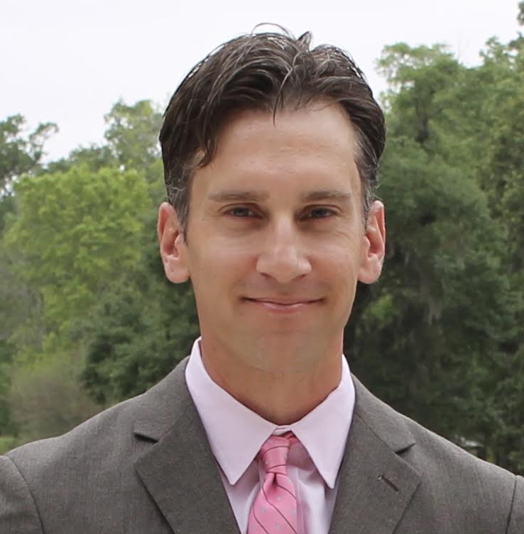
David S. Kirsch, MD
Practice type: Private
Practice location: Louisiana
Practice size: 17
Practice model: Partnership and employed

Slide 15
Radiology workforce deployment and preparedness for cross-discipline coverage
Initial reaction “Flee the hospitals”
All radiologists except IRs have been pulled from the hospitals
Robust telerad service with full-service IT employed by the group has allowed for continued subspecialty reads (MSK, Neuro, etc)
Consolidation on reading chairs
Deployed home workstations for all radiologists

Slide 16
Elective exam rescheduling process and implementation
Initial reaction “prayer”
Worked with hospitals and facilities to define and manage what is emergent/medically urgent/non-emergent
  All non-emergent cases and imaging have been deferred until May
  IR case volumes have declined but remain steady
  Oncology workups and treatments have proceeded with modifications pre and post
Expecting to have a large backlog of cases and imaging post COVID-19

Slide 17
Accommodating downstream increased demand after COVID-19
Initial reaction “panic and chaos”
Tricky but trying to maintain current level of radiologists
Future hiring very up in the air
  Hard to predict with certainty the future volume and revenue.
  Further complicated by difficult hiring atmosphere
Group forcing some vacation and random days off for now but plan to respond to future demands as they arise

Slide 18

Managing decreased revenue due to COVID-19
Initial reaction “more panic leading to group infighting”
Preparing weekly cash and work flow projections to determine scheduling
Applying for SBA and state loans, bank credit line, malpractice insurance deferral, accelerated payments from Medicare
15% reduction for salaried employees pending SBA loans
Reduction in partner payroll and bonuses; minimize use of independent contractor radiologists

Slide 19
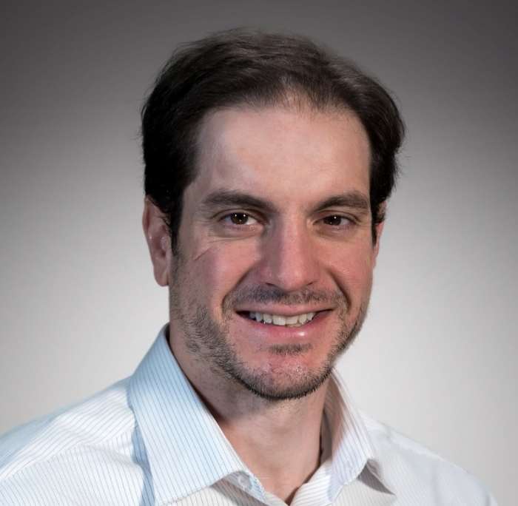
Mahmud Mossa-Basha, M.D
Vice Chair of Clinical Operations, University of Washington Medical
Practice type: Academic
Practice location: University of Washington, Seattle
Practice size: 150
Practice model: Employed

Slide 20
Radiology workforce deployment and preparedness for cross-discipline coverage
Submit to dean faculty roster to cover surge-sensitive areas in the hospital (ICU, acute care, ED) and level of guidance needed
Request from GME to provide list of residents who can provide coverage in surge-sensitive areas
  Chair and vice chair of operations in coordination with section chiefs listed faculty that could provide support in the acute care and ED units with guidance
    Included all faculty who were not at increased risk of infection or poor outcomes from COVID-19 infection
  Residency program director provided list of trainees who could cover surge-sensitive clinical services
    Request from GME for 30 residents for pooled coverage
Notes:
Guidance refers to basically operating on an intern level
Radiology has not been pulled into reserve coverage yet
Not anticipated to occur now that Washington state is beyond our peak which occurred on April 2 based on most recent modeling.

Slide 21
Elective exam rescheduling process and implementation
Automated text messaging system to communicate with patients the recommendation to reschedule outpatient elective exams
    Indicated that patients should communicate with their physicians to determine urgency of exams
    Provided rescheduling phone line
For new exam orders, requested that ordering physicians place in the indication box the time sensitivity of the study and the time frame in which imaging needed to be completed:
      Critical - immediately
      Urgent - within the next two weeks, three weeks, etc.
      Non-urgent - can wait for 2 months

Slide 22
Accommodating downstream increased demand after COVID-19
Increased operational coverage
  Prepared to have scanners running on weekends and late into evenings
  Urge staff to use PTO now to prepare for post-COVID increased volume coverage coverage
  Overtime for technologists and staff if needed
Maximize utilization of outpatient imaging centers
  Reduced faculty and trainee coverage now to prepare for increased volume coverage
Notes:
Faculty use of academic time and vacation now. Potential restriction of vacation time during the summer once the pos-covid surge comes.

Slide 23
Managing decreased revenue due to COVID-19
Estimated global 39-60% radiology volume drop, and 55-70% outpatient volume drop between various UW hospitals during COVID-related rescheduling
Cost reduction
    Deferment of faculty incentive payments
    Reduction/elimination of temporary supplemental payments for excess shifts
    Consolidation of clinical weekday and weekend coverage
    Hiring freeze for 6 months
    Reduction of faculty education allowance and section discretionary funds
    Support staff consolidation
    Consolidation of graduation events
    Shut down inefficient research cost centers - radiochemistry lab

Slide 24
Managing decreased revenue due to COVID-19 (cont’d)
  Revenue-generation acceleration of planned activities
    Increased efforts in teleradiology contracts
    Increased contract research organization work
    Stand-alone outpatient imaging centers with shared revenue model
    Additional revenue diversification models in planning

Slide 25
Michael Recht, MD
Practice type: Academic
Practice location: NYU Langone Health System (5 hospitals, several outpatient imaging centers)
Practice size: Approximately 230 faculty radiologists
Practice model: Faculty group practice

Slide 26
Radiology workforce deployment and preparedness for cross-discipline coverage
  Social Distancing
  Distributed home workstations to faculty who did not have them
  Limited on-site to skeleton staff
  Re-deployment
  Faculty
    Bedside IR Services – central lines, thoracentesis, etc
    Virtual employee screening
    “Family Connect”
    Volunteer re-deployment to ED, Medicine, ICU, ancillary support roles
  Staff
    Outpatient staff retrained for portable radiography
    Lists of outpatient staff who could fill in for hospital staff as needed
    Non-essential staff placed in “labor pool” for re-deployment

Slide 27
Elective exam rescheduling process and implementation
  Phase 1
    Rescheduled all screening exams
    Do 2-week blocks at a time and reschedule for June
    Consolidate hours
  Phase 2
    Only schedule non-elective exams
    Elective exams scheduled out several weeks
    Closed several sites and further consolidated hours

Slide 28
Research
Phase 1 – Prepare
  Cancelled all human research exams
  Checked helium levels on MR scanners
  Tasked managers of our core facilities with preparing contingency plans involving minimal/no staff
Phase 2 – Protect our team
  Shared centralized telework resources (VPN, videoconferencing access, etc)
  All staff and faculty work remotely
Phase 3 – Maintain Community
  Daily research updates
  Weekly Webex townhall
  Virtual coffee hours, social networking channels, targeted research group meeting
Phase 4 – Beat COVID-19
  Develop AI models for COVID-19 diagnosis and predictive analytics
  3D printing of face shields

Slide 29
Education
Clinical Rotations
  Limited number of residents per attending and reading room
  Created several new reading rooms to maintain social distancing
  Creating “simulated” daily worklists
Conferences
  All done remotely
  Released AUR Core Resident Curriculum
Educational/research projects
  Teaching files
  Rad-path cases for medical students
Re-deployment
  Several housestaff volunteered for medical services
Medical students
  Increased virtual lectures and activities

Slide 30
Accommodating downstream increased demand after covid-19
    Initiated several project improvements
    Scheduling
    Order sets
    Pre-cert
    Protocol optimization
    What will waiting room of the future look like?
    Increased use of online scheduling/screening
    Hours of operation

Slide 31
Managing decreased revenue due to covid-19
Part of faculty group practice
No salary decreases
No layoffs or furloughs
Eliminated all overtime and moonlighting
Capital projects put on hold

Slide 32
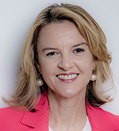
Geraldine B. McGinty, MD, MBA, FACR
Chair, American College of Radiology
Practice location: Weill Cornell Medicine, New York City

Slide 33

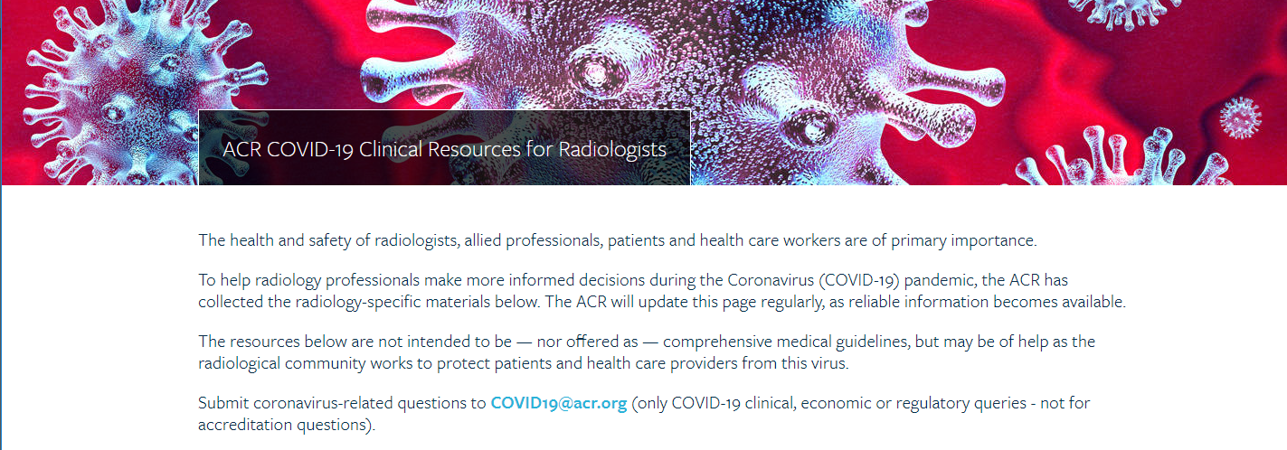
ACR Resources and Response

Slide 34

RLI Leadership Town Hall: Leading in Times of Crisis
Thursday, April 16, 7–8:30 pm ET
Learn how radiologists from COVID-19 hot spots are dealing with today’s challenges and leading in times of crisis.
Register at ACR.org.

Slide 35
Q&A

Slide 36
COVID-19
and Your
Radiology
Practice
Material presented reflect the best available experience and knowledge about COVID-19 and may need to be updated as more information becomes available.

