Slide 1
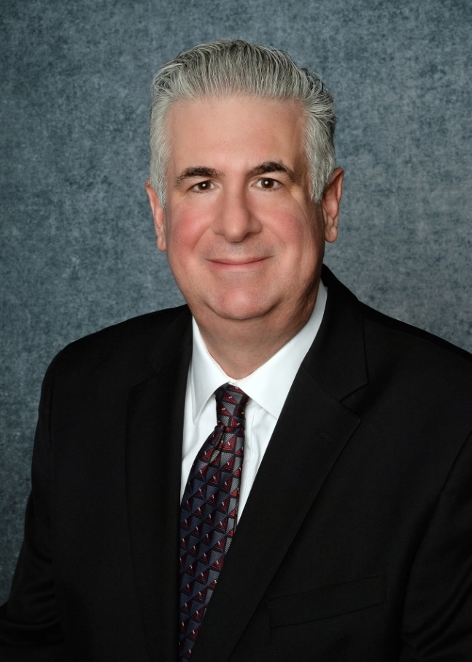


Working for the U.S. Department of Veterans Affairs (VA): Strategies for Success.
.
Ian Weissman, DO, FACR
  Chair, American College of Radiology (ACR) Veterans Affairs Committee.
  @DrIanWeissman

Slide 2


Slide 3




Disclosures
Member, ACR Council Steering Committee (Legislative Leadership).
First Graduate (Leadership Mastery), ACR Radiology Leadership Institute (2014).
Chair, ACR Commission on Patient and Family-Centered Care Outreach Committee.
Immediate Past President, Wisconsin Radiological Society.
Past President, Milwaukee Roentgen Ray Society.

Slide 4


Slide 5

Why work for the VA?
Thoughts:
  Evolving healthcare market.
    Optum (part of UnitedHealth Group).
      Now employs 90,000 physicians.
    Continued corporatization.
      Hospitals buying physician practices.
    Continued private equity acquisitions.
      Private equity now owns more than 30% of medical practices in nearly one-third of the metropolitan areas.
    Who do you want to be employed by?
Veterans Health Administration (VHA) is:
America’s largest, most technologically
advanced healthcare system,
  1,298 healthcare facilities.
    171 medical centers.
    1,113 outpatient sites of care of varying complexity (VHA outpatient clinics).
      Serving 9 million enrolled Veterans each year.
●www.beckershospitalreview.com/legal-regulatory-issues/optum-added-nearly-20-000-physicians-in-2023.html
●thehill.com/opinion/healthcare/4365741-private-equity-is-buying-up-health-care-but-the-real-problem-is-why-doctors-are-selling/

Slide 6
Why work for the VA?
VA is large.
Is VA too large to fail?
  As a consideration, radiology practices have been closing or have been absorbed.
Historically, strong bipartisan support for VA.
Many Veteran advocacy groups.
Budget for VA usually secured in advance.
  Less susceptible to government shutdowns.
Cybersecurity.
  Many firewalls through the government.
  More secure?
Veterans Health Administration (VHA) is:
America’s largest, most technologically
advanced healthcare system,
  1,298 healthcare facilities.
    171 medical centers.
    1,113 outpatient sites of care of varying complexity (VHA outpatient clinics).
      Serving 9 million enrolled Veterans each year.

Slide 8

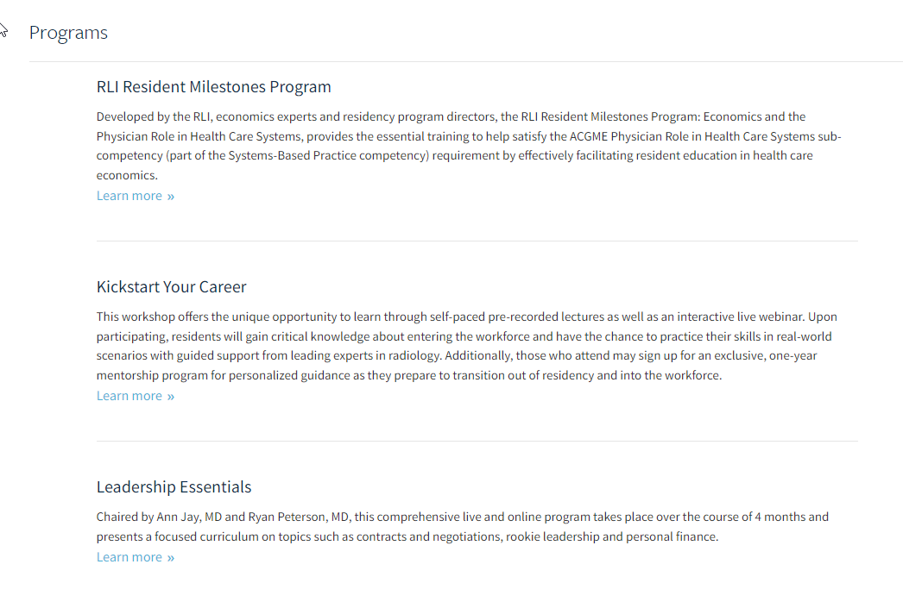
Strategy for success.
Educate yourself in the business of medicine.
  Not enough to only be an excellent clinician.
  Don’t have to have an MBA/MMM etc.
    However, would advise if anticipate taking on a leadership role.
  Listen/attend lectures, for example, by Lawrence Muroff MD, FACR and Frank Lexa, MBA, MD, FACR.
    Practice consultants for years.
    For example, how gently determine during a job interview if a practice will be selling to private equity?
      How do you feel about private equity?
        Opinion vs silence (gag clause).
      Have a clause put into your contract.
        If practice transitions to private equity before you’re a partner.
    Need to educate yourself!
      Medicine is a business--not family.

Slide 9

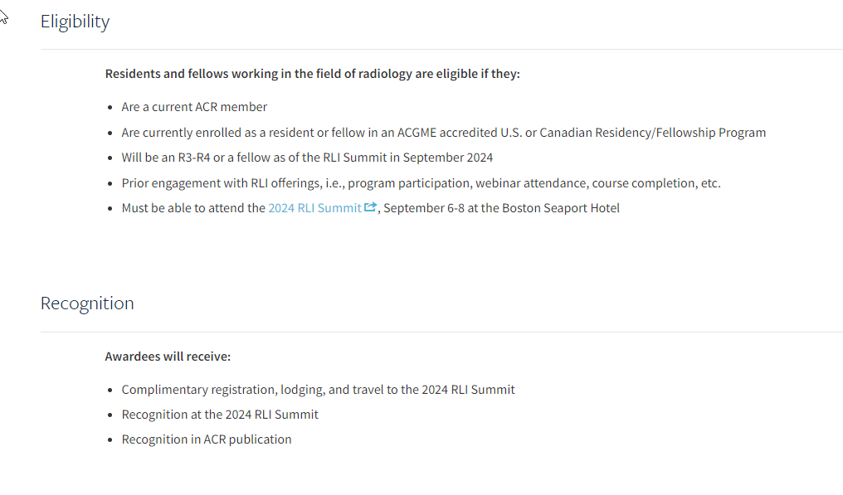
Strategy for Success.
Apply for the Emerging Leader Scholarship to attend a Radiology Leadership Institute Summit.
  If selected, Free.
I participated in the RLI Summit for over a decade.
  Most recently last year (2023), when I was awarded the Impact in Leadership Award.
    For work that I am doing on improving well-being in our colleagues (a different lecture).
  My observation. The focus of the RLI Summit has shifted toward younger radiologists.
    Last year, a session on understanding private equity.

Slide 10


Slide 11
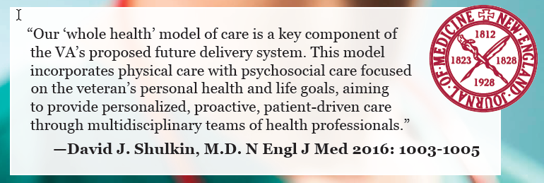
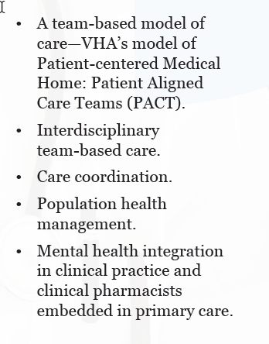
Why work for VA?
Veterans enjoy coming to VA.
  Also a social experience.
    Veterans share stories with each other.
Excellent patients. Very grateful for the care they receive.
  Great patients to collaborate with.
    Veterans (our nation’s heroes).
Recent story.
  I called patient at home a couple of weeks ago (putting on my patient and family-centered care hat now. I Chair ACR’s PFCC Outreach Committee).
  Outpatient imaging; ankle fracture; come to ER. He could go to community hospital if closer. He is 71 years old (he was in pain).
    “No, I would prefer to come to VA.”
  Strategy for Success: I encourage you to call patient’s at home. You are their Doctor.
Former VA Under Secretary of Health (2015-2017).

Slide 12
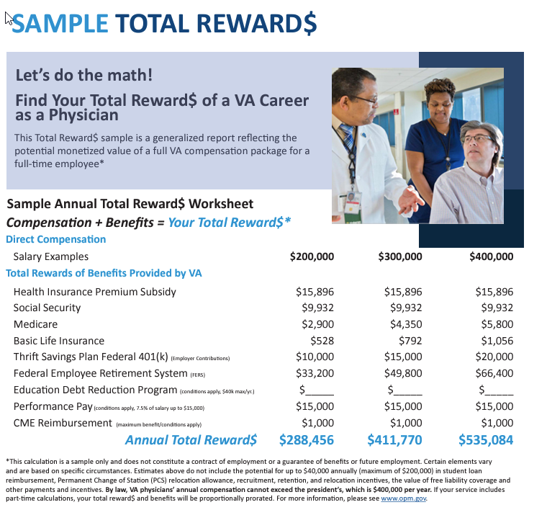
Why work for VA?
By law, VA physicians’ annual salary cannot exceed the President of the United States, which is $400,000 per year (determined by Congress).
  This is being reassessed with physician shortages in many specialties, including radiology.
Advantages:
  Salary is stable. Not be reduced/held (e.g., COVID).
  Salary is from the federal government. If federal government fails, we’re all in trouble.
  Receive, a 401K plan (TSP), matched by employer.
  Also get a Federal pension (adjusted for inflation).
    You will get your Federal pension.
    Again, if government fails, we’re all in trouble.
  Take your federal healthcare plan (excellent plan) with you for life (need to work at VA for 5 years; need to be at certain age (mid 50’s).
    Can retire before Medicare and/or ACA.
  Your practice will not be purchased by a hospital corporation or by private equity (biannual salary raises).

Slide 13
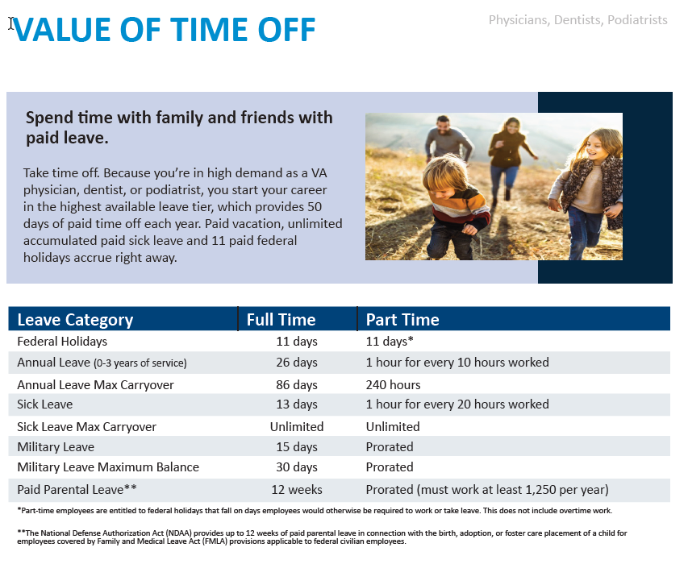
Why work for VA?
Other benefits.
  Many physicians now value time off to spend with family or pursue other interests.
    37 paid days off per year plus 13 days of sick leave (50 days total). 12 weeks paid parental leave.
    I work a 4 day work week. 10.5 hours per day. Gives me a day off per week to pursue other interests like patient advocacy.
      This in addition to the 50 days off per year (so 102 paid days off per year).
  Strategies for success.
    Try to get a starting salary as close to 400K as you can.
    Make sure you will receive the performance pay of 15K per year.
    Take advantage of the $1000 per year for CME. (Affiliated academic institution $200 to $4000 per year depending on profits).
    40 hours of CME per year (receive in writing if possible; used to be 90 hours of CME per year).
    Ask for a retention bonus. (e.g., 30K year for a committed 2-year obligation).
    Investigate education debt reduction programs (up to 40K per year over 5-years).
    New VAContractBuyoutProg@va.gov (buys out obligations).

Slide 14


Slide 15
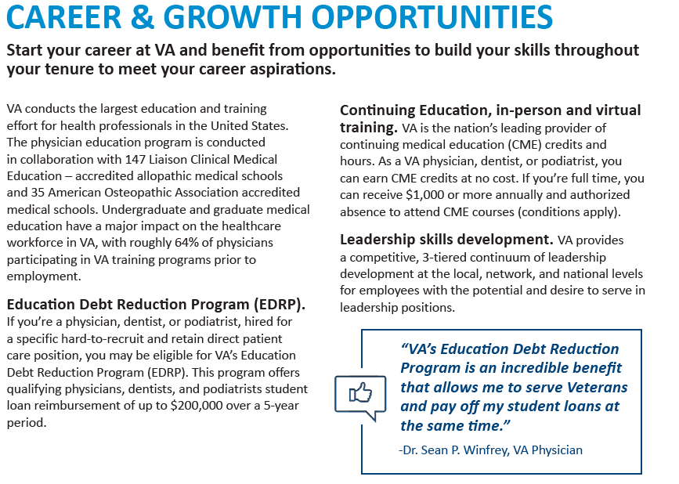
Why work for VA?
Strategies for success.
  Need mentors and sponsors.
  May be able to accomplish professional growth/goals oneself, but it will take longer.
    As physicians we’re trained to be independent/self-sufficient.
    However, need help from others (people with experience and knowledge).
    Have to shift the mindset from ME to WE.
  VA has the Institute for Learning, Education and Development (ILEAD).
    Examples. I completed the VA Supervisor Ready Program through this Institute (attended it on my day off per week).
    Received 2-years of free professional Coaching through VA.
    Many online leadership resources.
    Completed Stanford’s Physician Well-Being Directors Course (now part of its cohort; on my day off per week through VA).

Slide 16
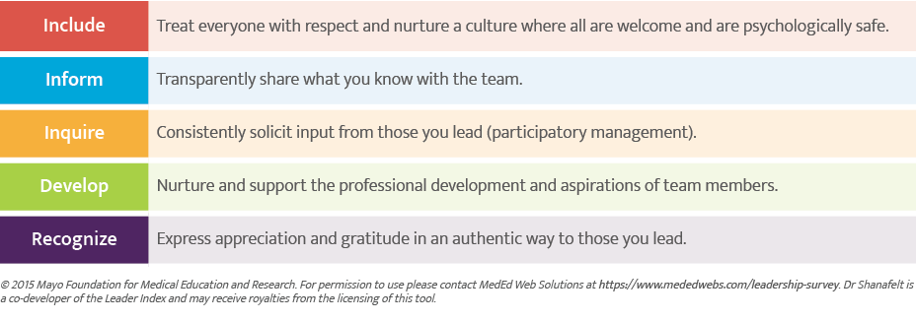


What critical to evaluating a job (regardless of practice setting)?
Strategies for Success.
  Leadership behavior.
    Outweighs everything else.
  Cultivate a culture of community, connection and support.
Bottom-line:
  We, as clinicians, need to work together, with our respective organizations.
  Create a positive work environment by:
    Sharing ideas.
    Proposing solutions (e.g., NAM, U.S. Surgeon General).
Five Leader Behaviors to Cultivate Positive Leadership:

Slide 17
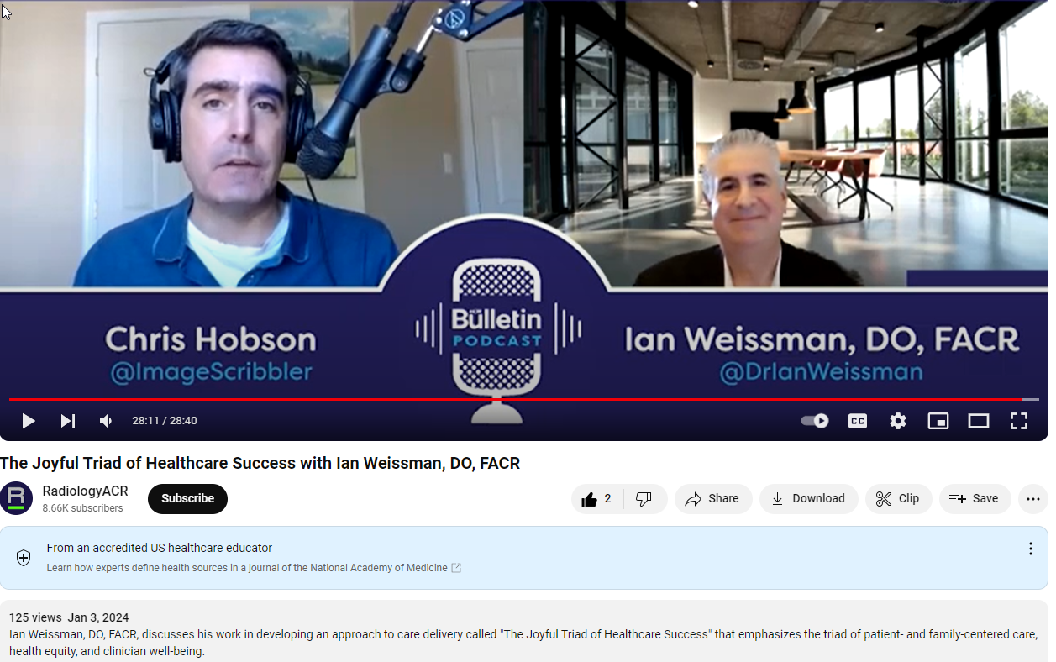
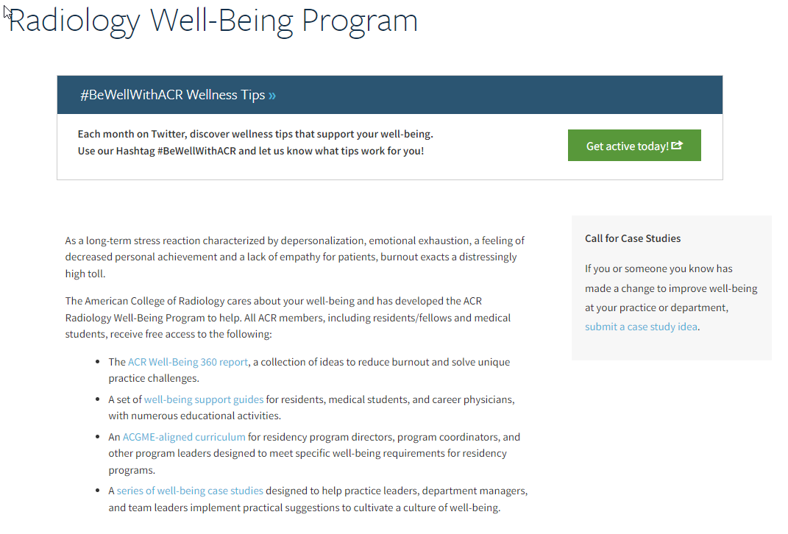
What is critical to finding a fulfilling job?
Strategies for Success.
  Need to find a radiology position where you work for a servant leader.
    Both Lori Deitte, MD, FACR, FAUR (A member of the ACR’s Board of Chancellors and Chair of ACR’s Commission on Publications and Lifelong Learning) and myself are working hard to provide resources for you to be well in your practice.
    Every physician is critical to the success of our healthcare system (great healthcare resignation is underway).
  Try to pick well the first time.
  I give a Grand Rounds on what I call the Joyful Triad of Healthcare Success.
    I share strategies on what you should be looking for in a radiology position. Archived: YouTube (RadiologyACR). Will help you evaluate a job.

Slide 18


Slide 19
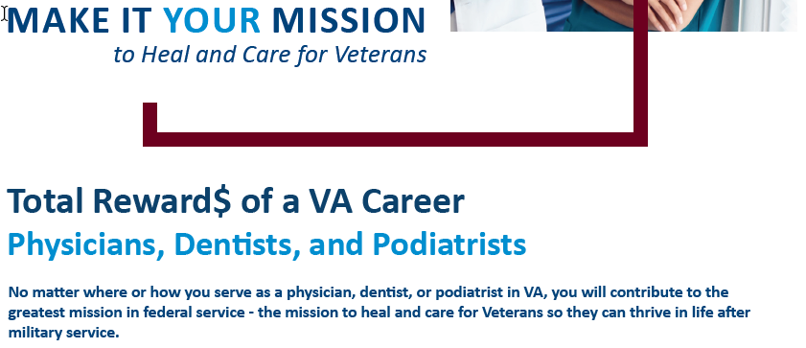
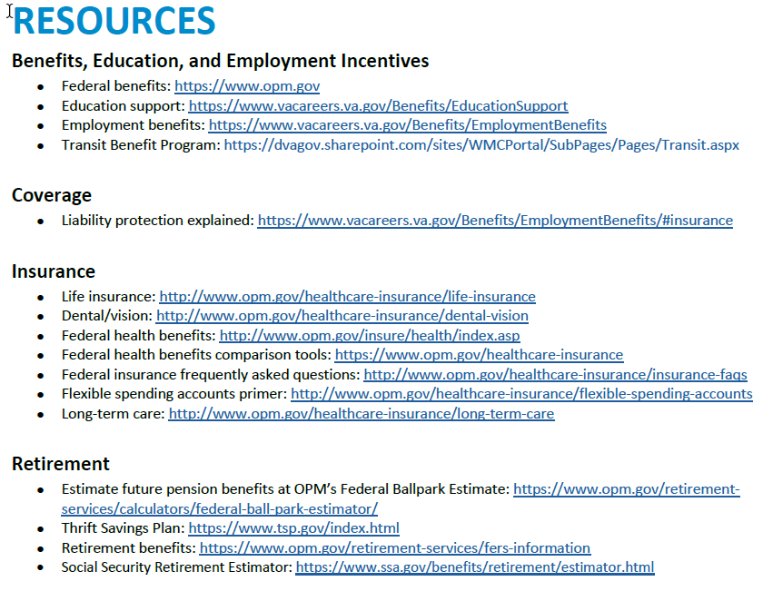
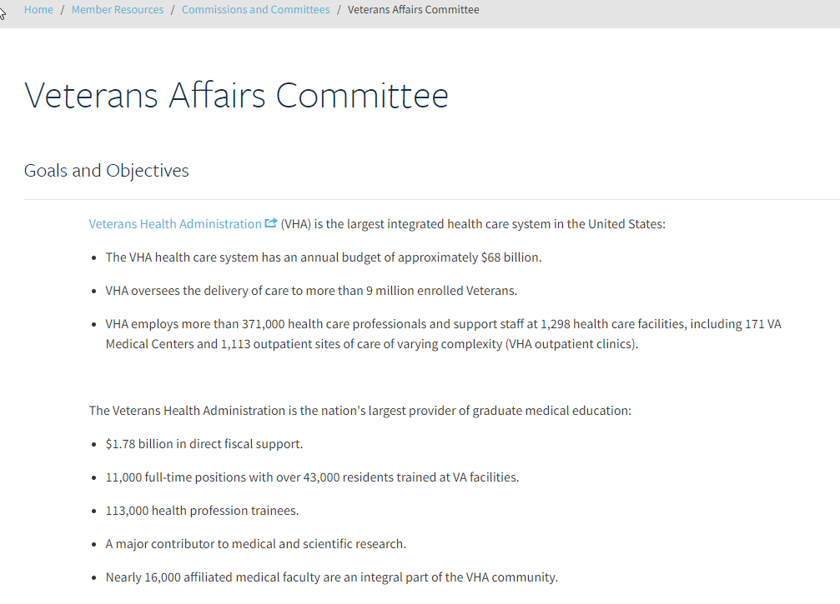

Why work for VA?
Resources.
  https://vacareers.va.gov/careers/physician-jobs/
    Total Reward$ of a Physician Brochure (March 2023).
  https://www.acr.org/Member-Resources/Commissions-Committees/Veterans-Affairs
    Reduced ACR membership rates (VA/Military).
    Reduced subscription rate (MRI Online/Medality)--2024.
American College of Radiology

Slide 20


Slide 21


Slide 22


Slide 23

Summary: Strategies to Achieve Well-Being
  Resources/Education
    ACR Radiology Well-Being Program.
    National Academy of Medicine.
      National Plan for Health
      Workforce Well-Being.
    U.S. Surgeon General (Two of the six current priorities).
      Health Worker Burnout.
      Workplace Well-Being.
  Thought Leaders
  Social Media
  Summits/Seminars
    Doctor’s Day at the Wisconsin State Capitol.
ACR Radiology Well-Being Program. 2019. www.acr.org/Member-Resources/Benefits/Well-Being
National Academy of Medicine. National Plan for Health Workforce Well-Being. October 2022. https://nam.edu/initiatives/clinician-resilience-and-well-being/national-plan-for-health-workforce-well-being/
U.S Surgeon General. Health Worker Burnout. May 2022. www.hhs.gov/surgeongeneral/priorities/health-worker-burnout/index.html
U.S. Surgeon General. Workplace Mental Health and Well-Being. October 2022. www.hhs.gov/surgeongeneral/priorities/workplace-well-being/index.html
(NEW) Weissman I, Van Geertruyden P, Prabhakar A, Fessell D, Alson M, Lexa F. Resources to Address Radiologist Burnout. JACR, March 17, 2023. www.sciencedirect.com/science/article/abs/pii/S1546144023002570

Slide 24
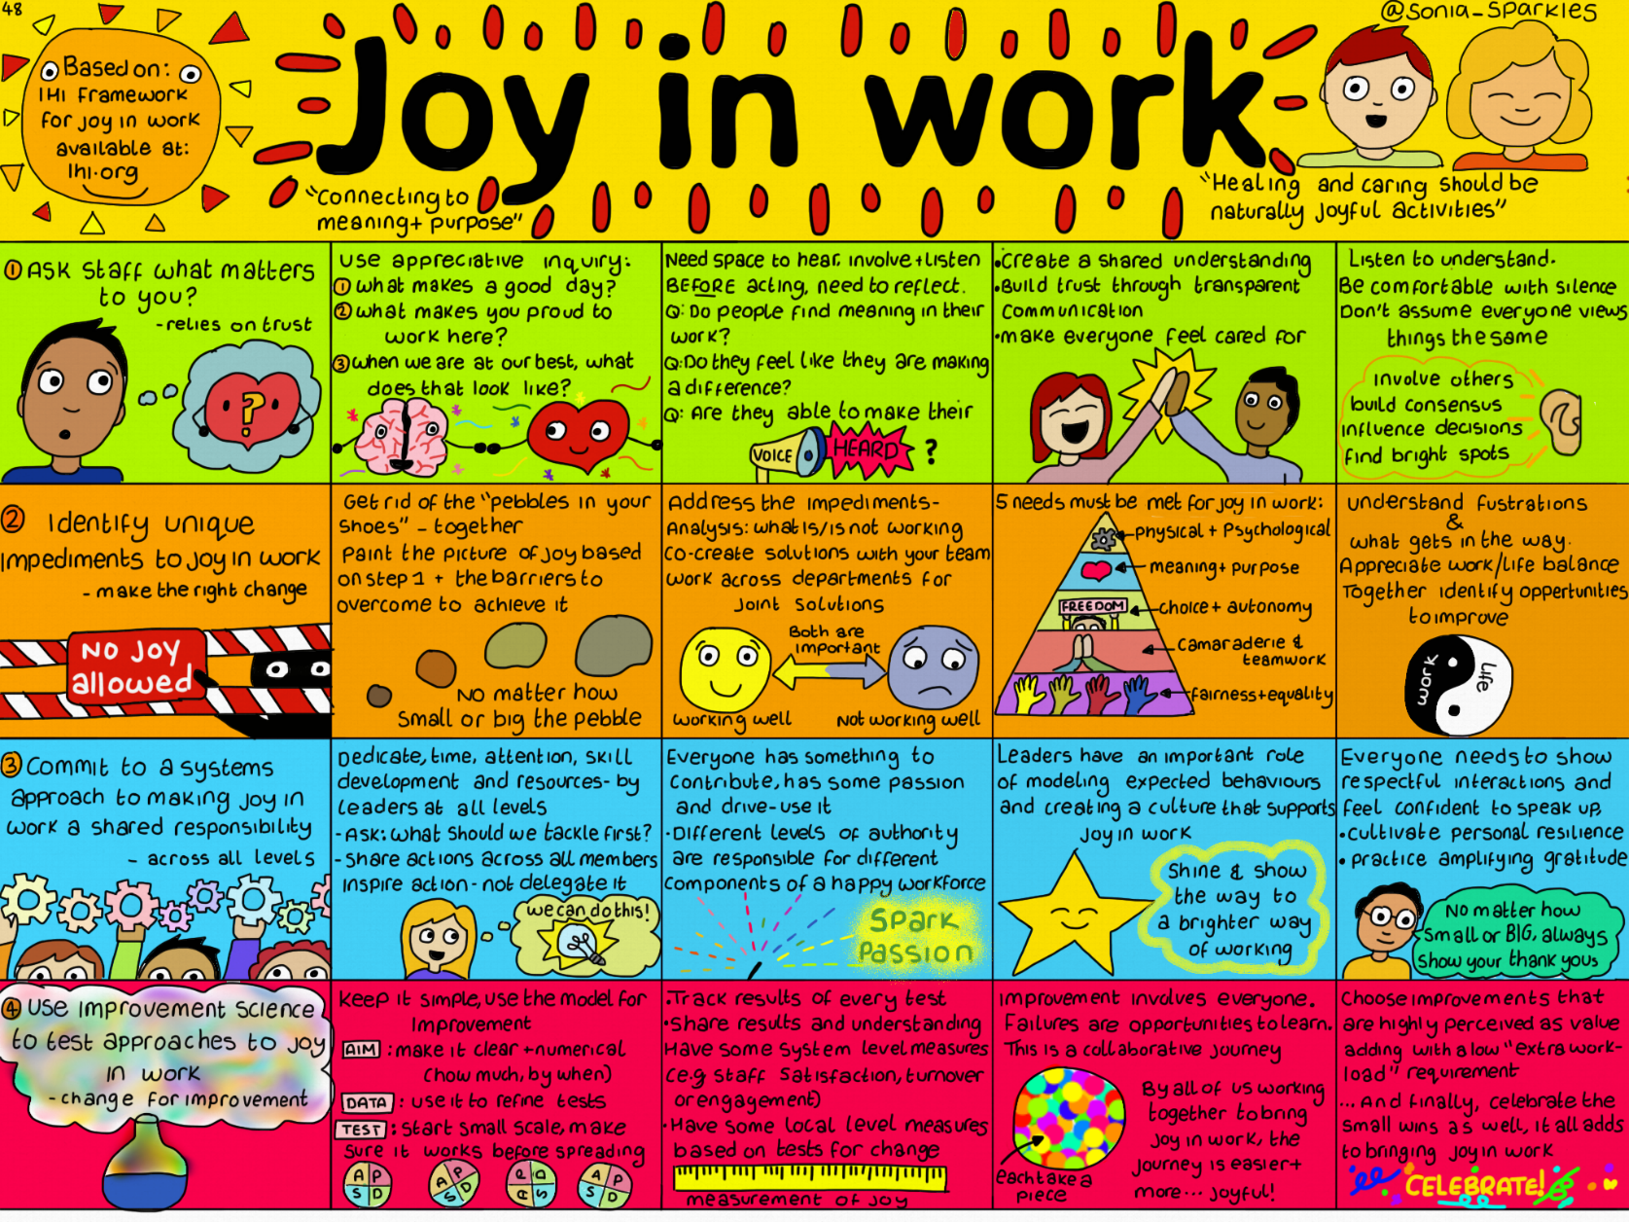
Conclusion: Reach for the Joyful Triad of Healthcare Success
I believe that if we embrace strategies to:
  Improve patient and family-centered care.
  Improve health equity.
  Improve clinician well-being.
    Both in ourselves and others.
We will experience joy in our work.
  Remember: Joy is an attitude that defies circumstances.
Perlo J, Balik B, Swensen S, et al. IHI Framework for Improving Joy in Work. IHI White Paper. Cambridge, Massachusetts: Institute for Healthcare Improvement; 2017. (Available at ihi.org)

