Slide 1
State Legislative Update
Eugenia Brandt — ACR® Senior Government Affairs Director
Dillon Harp — ACR Senior State Government Relations Specialist
Carly Simpson — ACR Public Affairs Specialist

Slide 2
Agenda
ACR 2022 State Legislative Roundup
Scope of Practice Activity
ACRA Scope of Practice (SOP) Grant
New Resident Advocacy Initiative
Advocacy & PR
Questions

Slide 3
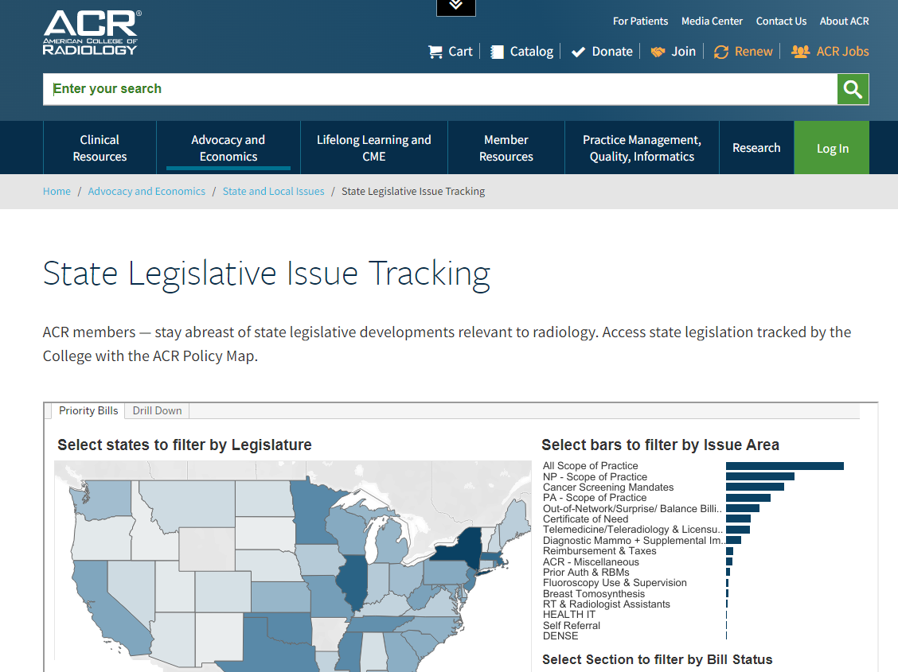
50 State Bill Tracking via acr.org ~ 450+

Slide 4
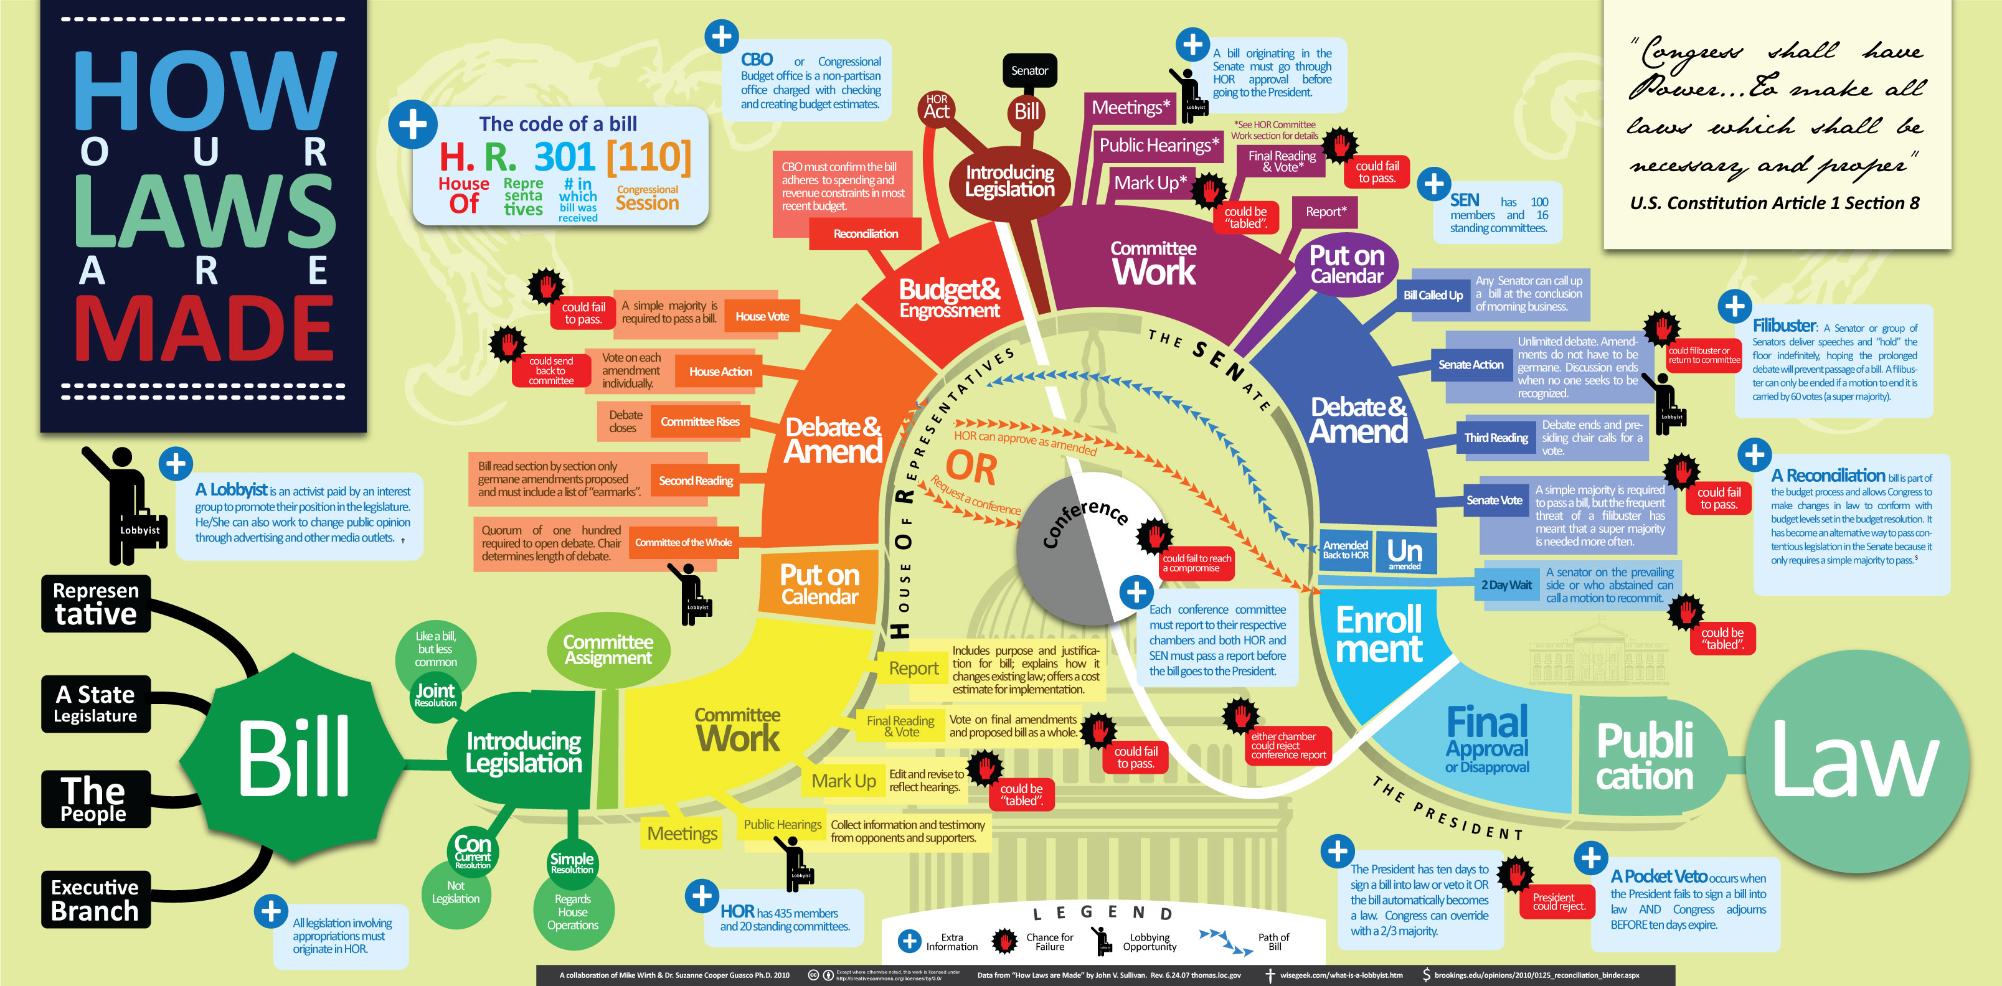
State & Federal

Slide 5
Highlighted Issues
Breast Health Legislation — During 2022 legislative session, staff tracked 30+ legislative measures on mandating coverage for breast cancer screening, diagnostic workup coverage parity, digital breast tomosynthesis (DBT) and requiring written reports for breast density. Measures related to breast cancer screening were signed into law in Georgia, Tennessee, Ohio and Oklahoma (not ERISA plans, only ones regulated at state level).
CA SB 974 To provide coverage without imposing cost sharing for screening mammography and medically necessary diagnostic breast imaging, including diagnostic breast imaging following an abnormal mammography result, and for an enrollee or insured indicated to have a risk factor associated with breast cancer, except as specified. Enrolled: 9/8/22.
GA HB 733 Modify definition of mammography to include both screening and diagnostic procedures and to provide that diagnostic breast examinations shall not be treated less favorably than supplemental screening mammography for cost-sharing requirements. Effective date: 5/6/2022.
OK HB 3504 To require carriers to cover diagnostic mammography which would include breast MRI and ultrasound, and modify the definition of screening mammography to include breast tomosynthesis. Approved by Governor: 05/20/22.
OH HB 371 Modify definition of “screening mammography" to include digital breast tomosynthesis and a mandate to cover supplemental screening for patients who meet stipulated conditions. Effective: 9/23/22.
TN SB 2771 To provide coverage for imaging services for screening mammography, including a baseline mammogram for a woman 35 to 40 years of age, and to provide coverage for diagnostic imaging and supplemental breast screening. Pub. Ch. 1068. 6/1/22.

Slide 6
Highlighted Issues (cont’d)
Out-of-Network Reimbursement and Enforcement of Federal No Surprises Act — ACR and Maryland Radiological Society co-signed a stakeholder letter in Maryland in response to draft rule making. The letter outlined the stakeholders’ concern over removal of provisions that would have held insurers accountable for network adequacy.
CO HB 22 Health Insurance Surprise Billing Protections. The act changes current state law to align with the federal "No Surprises Act." Governor signed: 6/8/22.
GA SB 566 Surprise Billing Consumer Protection Act. Modification for medical or traumatic condition to include a mental health condition or substance use disorder and to clarify that emergency medical services include post-stabilization services. Effective date: 7/1/22.
IL HB 4703 Amends the Illinois Insurance Code on provisions for emergency services or covered ancillary services from a nonparticipating provider or a nonparticipating facility. Contains provisions concerning a notice and consent process for out-of-network coverage. Makes a change in provisions concerning disclosure of nonparticipating provider benefits. Effective: 7/1/22, except that certain changes take effect 1/1/23.
LA SB 90 Network Adequacy provisions for health insurer benefit plans. Effective date: 1/1/23.
NJ S 1177 Revises out-of-network arbitration process. P.L.2022, c.74. 7/29/22.
NJ A 4139 Requirements for copies of medical and billing records to be provided without charge to Social Security Disability benefits applicants and recipients. Approved P.L.2021, c.359.
WA HB 1688 Aligning state law and the federal no surprises act and addressing coverage of treatment for emergency conditions. Effective date: 3/31/22.

Slide 7
Highlighted Issues (cont’d)
Prior Authorization & “Gold Card” — Legislation to reform the prior authorization process was enacted in Texas in 2021 and was under consideration in other states. Texas enacted legislation requiring state-regulated plans to offer prior authorization “gold-cards” to physicians with 90% prior authorization approval ratings for a particular service under that plan. New microsite dedicated to “gold card” legislation is being developed in time for next legislative session. Gold card bills were introduced in Colorado, Indiana, Kentucky, Louisiana, Mississippi, New York and Oklahoma this year.
SC HB 3775 To provide patients covered for stage four advanced metastatic cancer treatments to certain expedited external reviews of plan denials of certain diagnostic imaging service claims.
Currently, Vermont is running statewide gold card pilot programs for both Medicaid and private insurers. According to a 2020 report from the Vermont Department of Health Access, the gold card program provided "a notable example of success in improving clinal results and reducing administrative burden for healthcare professionals" who used it for Medicaid radiology services.
CT Colonography
Lung Cancer Screening
CON & Self Referral
Scope of Practice

Slide 8
2022 State Legislative Overview — Scope of Practice (SOP)
ACR tracked 30+ scope of practice bills that directly impacted radiologists
Notable scope bills that were signed into law:
HI — Expanded the definition of a patient’s provider to include PAs.
IN — Passed a Truth in Advertising bill that requires healthcare professionals to prominently state their profession or license.
KS — Granted nurse practitioners independent authority to prescribe durable medical equipment and medication.
NH — Changed the practice agreement between a PA and physician to a collaborative agreement.
NY — Allows a nurse practitioner (NP) with more than 3,600 hours of experience to practice without a written practice agreement with a physician.

Slide 9
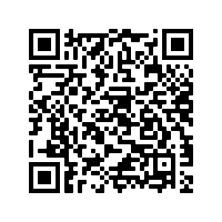
ACRA® SOP Grant
Established in 2021 with an initial funding amount of $225,000.
Grant is open to any state radiological societies that are fighting non-physician scope legislation in their state.
Last year five state radiological chapters were awarded funds,
KS, MI, NY, PA and WI.
Total of $75,250.
Grants are awarded up to $25,000 per year.
Learn more:

Slide 10
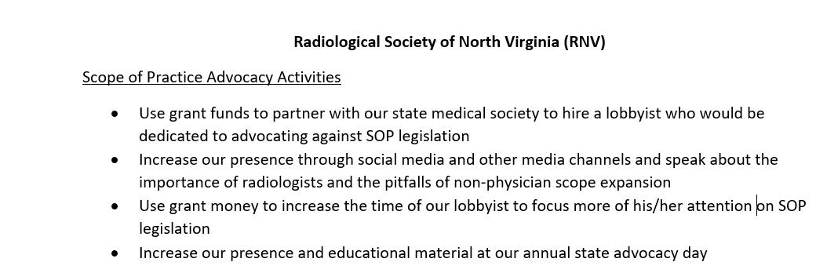
Mock SOP Grant

Slide 11
Advocacy Case Study: Wisconsin
During Wisconsin 2022 legislative cycle, SB 394 was introduced and was heavily pushed by various non-physician medical groups (WI Nurses Association, American College of Nurse-Midwives, etc.), which would have removed physician supervision or collaboration requirements for nurse practitioners, nurse anesthetists and clinical nurse specialists after 3,840 clinical care hours in their respective APRN role with a physician or dentist.
Alongside various medical specialty groups, the ACR and Wisconsin Radiological Society (WRS) were involved in advocating against this legislation.
SB 394 quickly passed both the Wisconsin House and Senate and was sent to Wisconsin Governor Evers’s desk for further action.

Slide 12
Advocacy Case Study: Wisconsin
While ACR and WRS advocated against this bill while it was being debated in the Wisconsin House and Senate, our collective advocacy efforts intensified once the bill reached Governor Evers’s desk.
Upon Governor Evers’s receiving SB 394, ACR and WRS sent multiple action alerts to all Wisconsin radiologists urging them to contact Governor Evers and explain why giving APRNs independent practice would negatively impact a patient's quality of care in Wisconsin.
WRS also sent a letter, on behalf of their state society, explaining the negative impacts of this legislation and asking Governor Evers to veto SB 394.
After much deliberation Governor Evers vetoed SB. 394 and published his rationale for the veto.

Slide 13

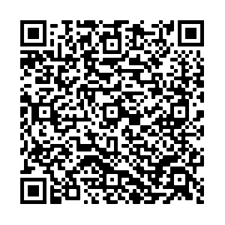
Learn More About Wisconsin’s Success

Slide 14
New Resident Advocacy Initiative
Started two months ago.
Already spoken to radiology residents in NY and TX.
Presentations can by fully led by ACR staff or done in combination with state chapter leaders.
For more information reach out to Dillon Harp at dharp@acr.org.

Slide 15
Meet the ACR Public Affairs Team
Shawn Farley – Director of Public Affairs
Kevin Walter – Manager of Public Affairs
Carly Simpson – Public Affairs Specialist
Adrian Kosmicki – Public Affairs Assistant

Slide 16


Advocacy in Action E-Newsletter

Slide 17
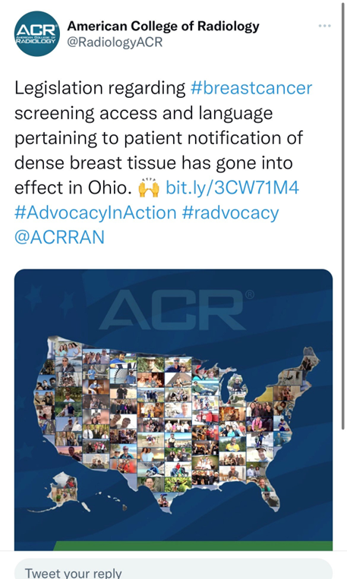
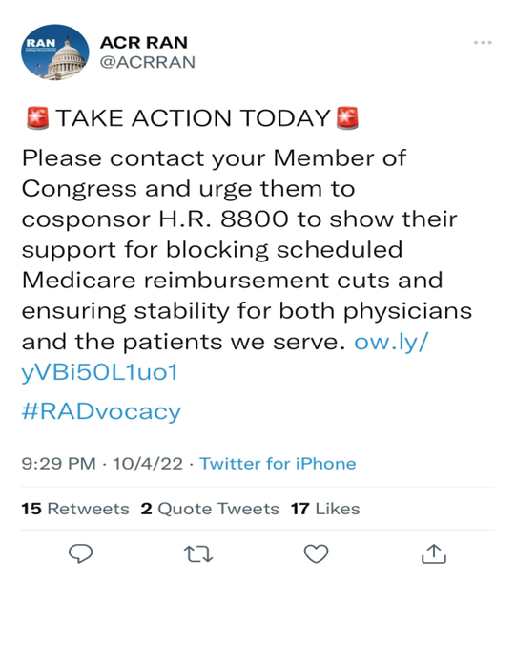
News You Can Use

Slide 18
Recent Public Affairs Activities
Hosted Digital Media Tour for Breast Cancer Awareness Month.
Upcoming Lung Cancer Awareness Month Digital Media Tour.
Advocacy E-news: Report Insurer Attempts to Cancel Contracts and/or Lower Reimbursement.
Press Release: Insurer Calculation of Qualified Payment Amount for Out of Network Care May Violate No Surprises Act.

Slide 19
Media Tips
Use your in-house PR staff. Don’t have one? Contact us at PR@ACR.org
Personal Appearance (for video) — Keep it Simple!
Wear solid colors (blue is always good).
No dangly earrings, elaborate necklaces or hats.
Background: Bookcase or lamp and plant.
Stay on Message.
You control what you say.
No such thing as “off the record.”
If asked a vague question (“tell me about mammography”) — state your primary 3-4 points. Make the reporter stop you.

Slide 20
Contact Us!
Eugenia Brandt
ebrandt@acr.org
Dillon Harp
dharp@acr.org
Carly Simpson
csimpson@acr.org

Slide 21


